Slide 1
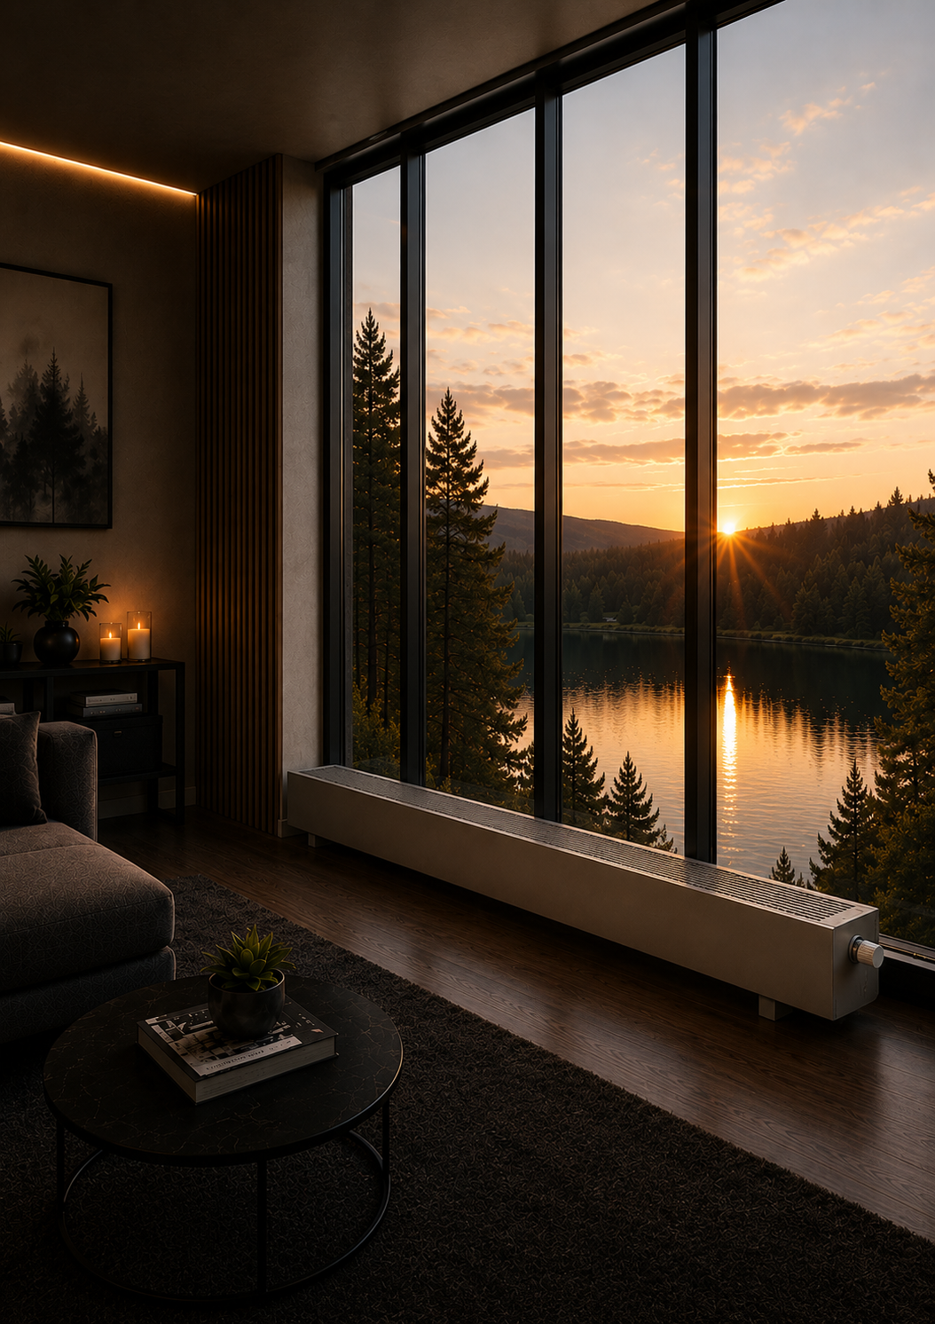





SC
FREESTANDING CONVECTORS
SC and SC-H
EFFICIENT SILENT HEATING
CLASSIC DESIGN
HEATING
NATURAL CONVECTION
ABSOLUTE SILENCE
SUITABLE FOR LOW-TEMPERATURE
SYSTEMS
QUALITY. RELIABILITY. INNOVATION.
MADE IN EUROPE

Slide 2
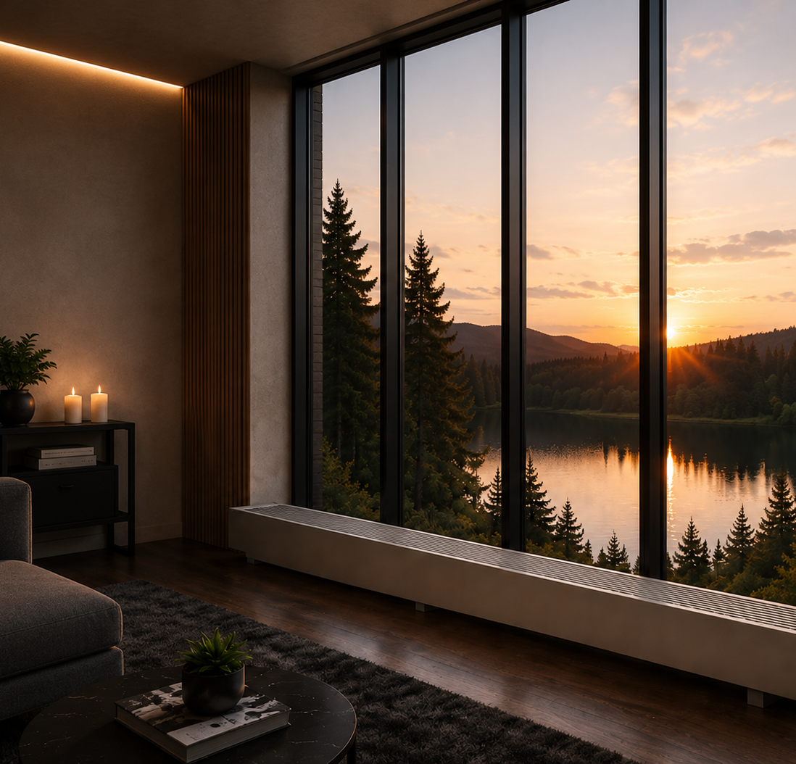
NATURAL HEAT FOR MODERN ARCHITECTURE
SC and SC-H convectors work on the principle of natural convection –
without fans and without noise.
Optimally designed heat exchangers create a gentle, evenly distributed heat curtain at the window, maintain a comfortable room temperature and keep the cold from entering.
SC and SC-H are an elegant, durable and economical solution for modern architecture.
HEATING
NATURAL CONVECTION
ABSOLUTE SILENCE
Natural convection
principle
Gentle, even heat throughout the whole room volume
Works without fans - no mechanical noise
02 | FREESTANDING CONVECTORS SC

Slide 3





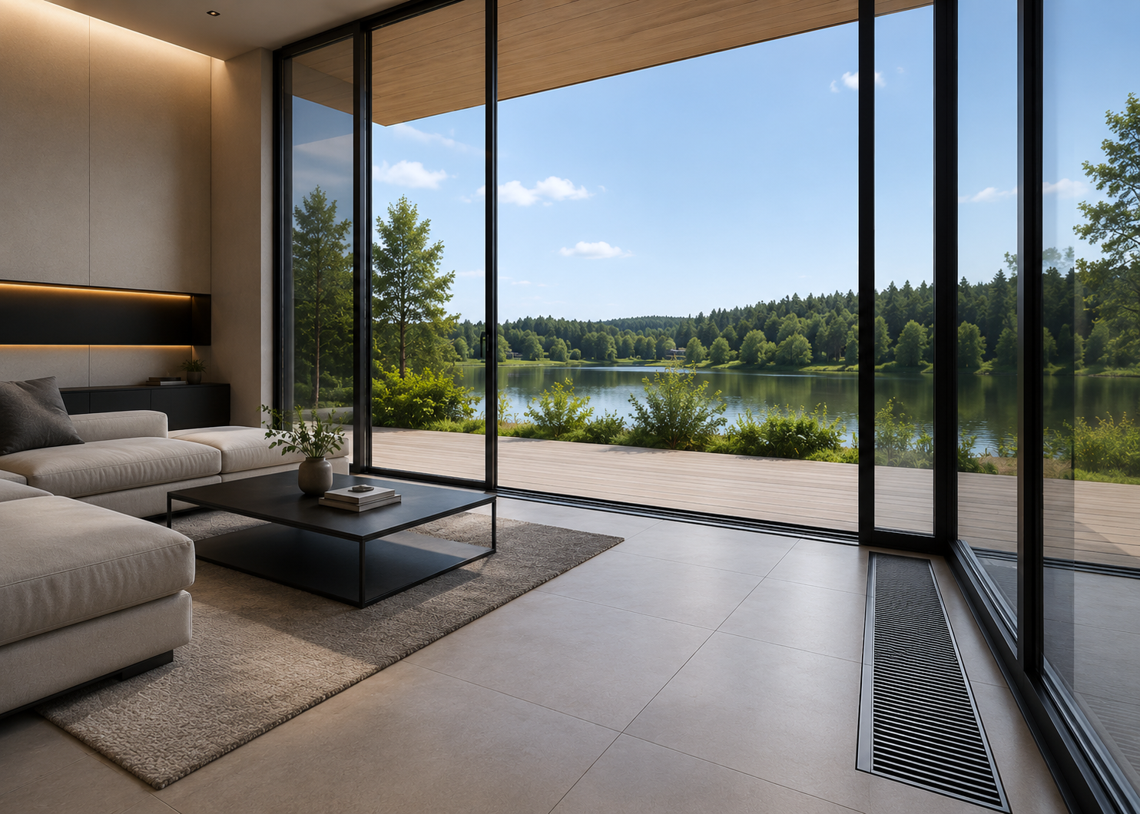
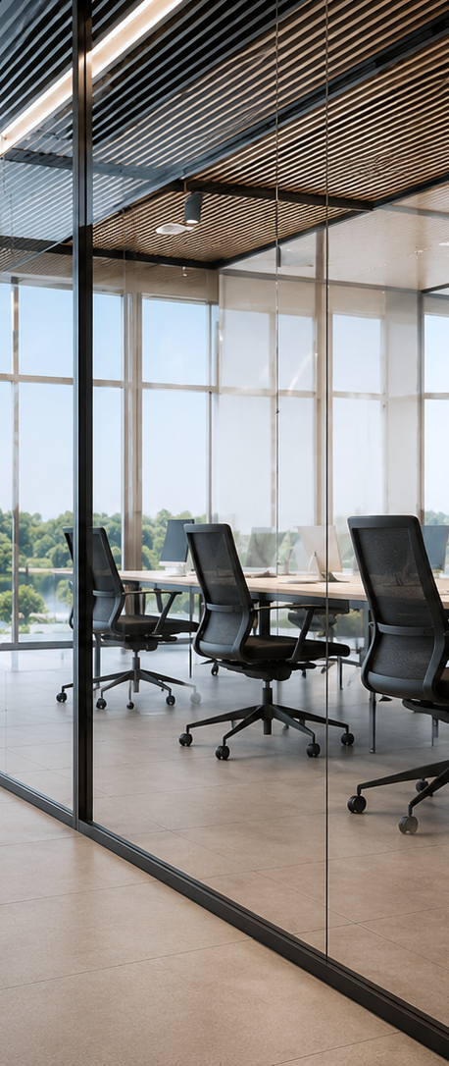
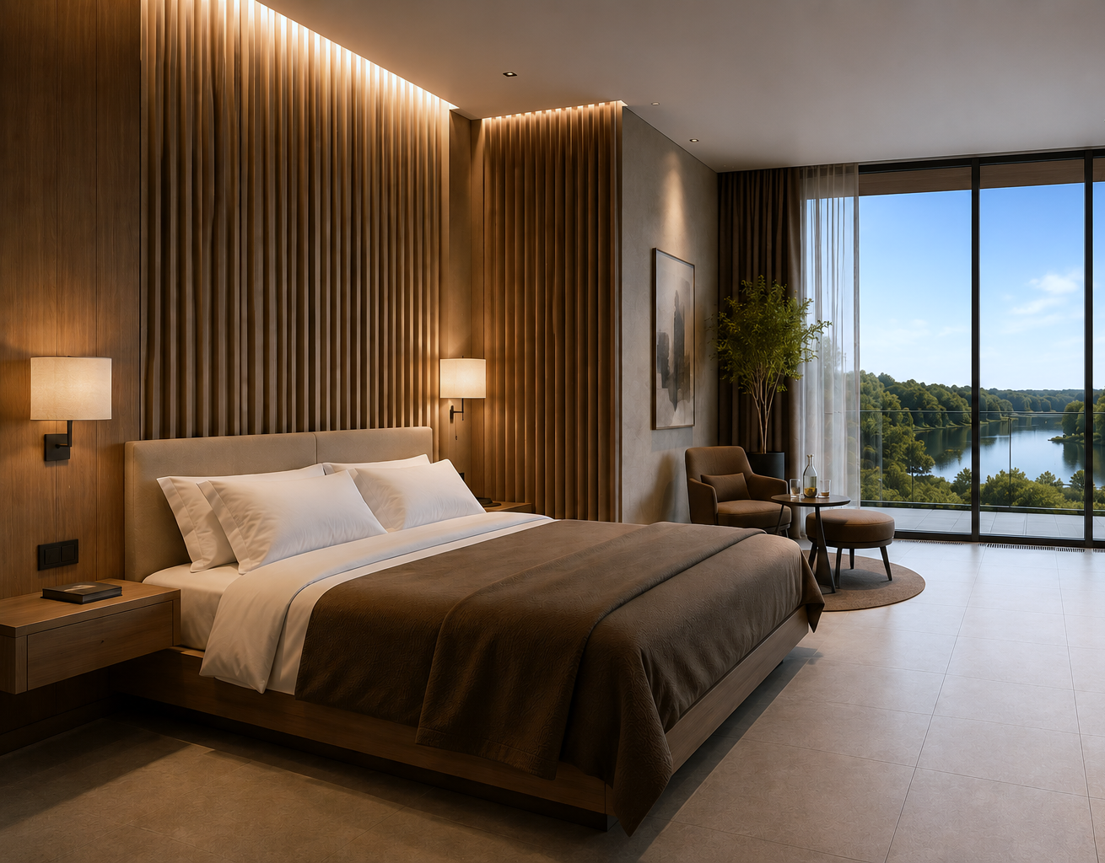
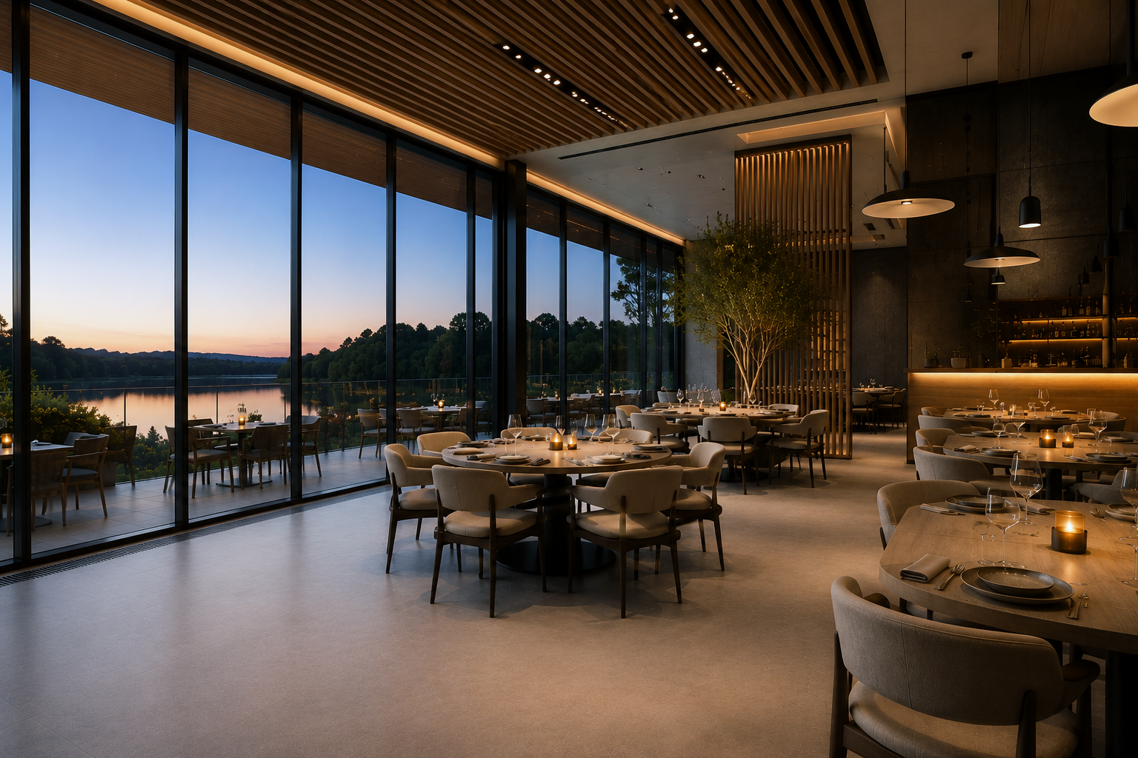
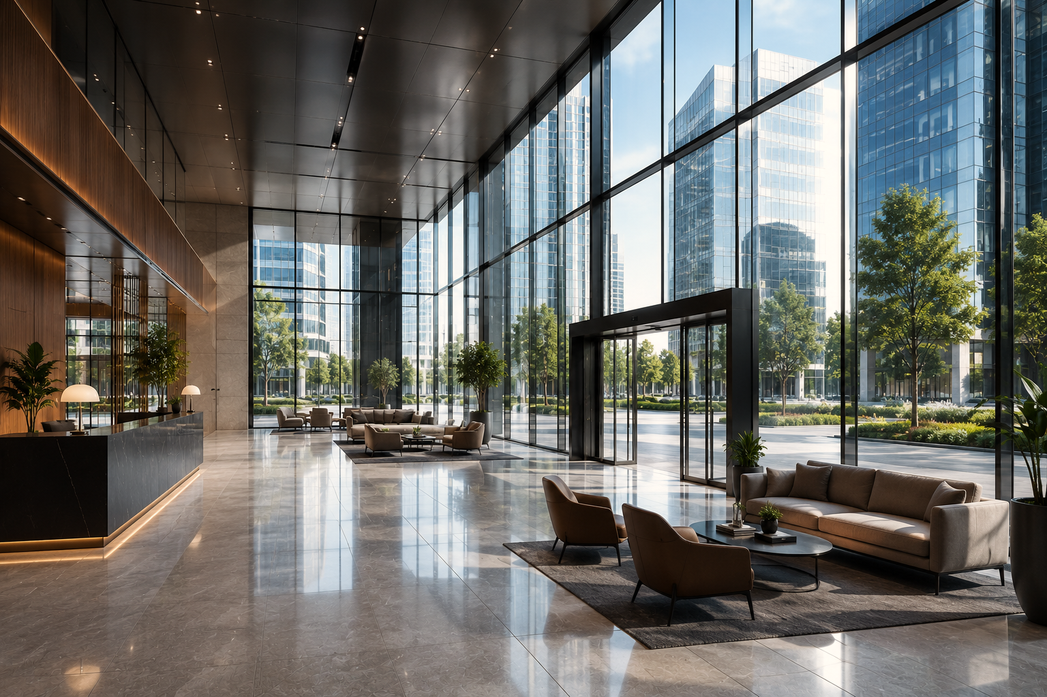





CREATED FOR CLEAN LINES
AND A COMFORTABLE ENVIRONMENT
EN 442 CERTIFIED OUTPUTS
NON-INERTIAL OPERATION
ABSOLUTE SILENCE
Tested in an independent accredited laboratory according to the European standard EN 442
Reacts quickly to temperature changes and precisely maintains the set comfort level
Works on the principle of natural convection without fans and mechanical noise
SAFE SURFACE
10-YEAR HEAT EXCHANGER WARRANTY
RAL COLOUR PALETTE
The casing surface temperature does not exceed 40°C
Reliability and durability for everyday use
Painted in any RAL colour
WHERE DOES IT FIT?
Residential houses
Offices
Hotels
Restaurants
Commercial spaces
FREESTANDING CONVECTORS SC | 03

Slide 4
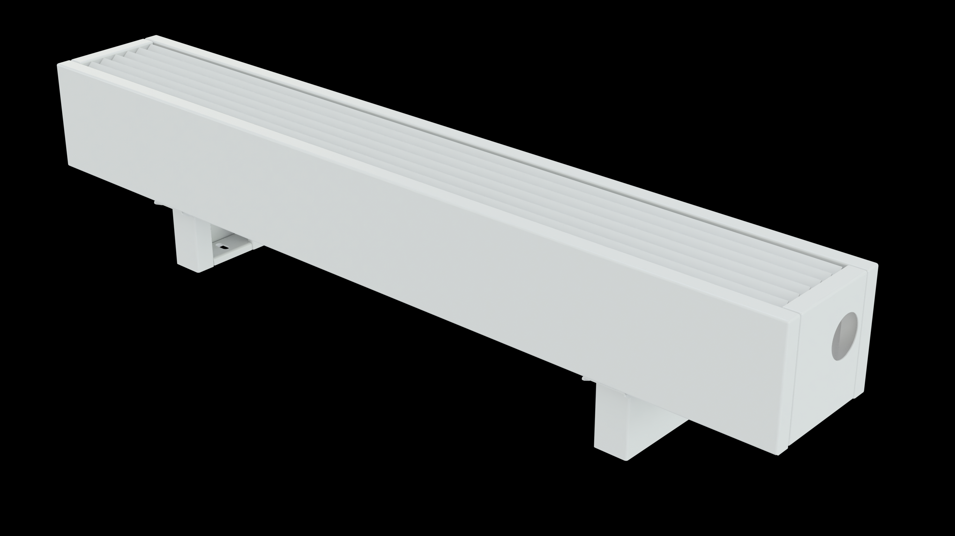
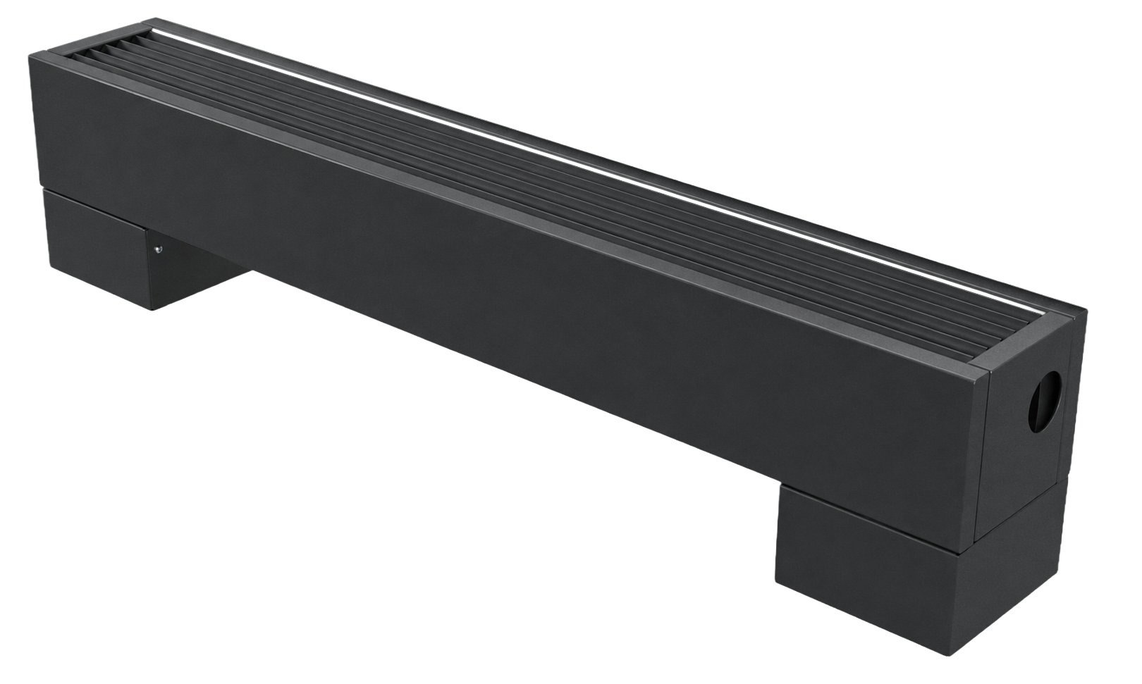




SC or SC-H?
THE RIGHT CHOICE FOR EVERY PROJECT
SC and SC-H convectors are built using the same natural convection technology, the same copper-aluminium heat exchangers and feature identical technical characteristics
The only difference is the design
SC
CLASSIC DESIGN
SC-H
MODERN DESIGN
Classic form
Modern form
The same heat exchangers
The same heat exchangers
The same output
The same output
The same connections
The same connections
THE ONLY DIFFERENCE IS THE DESIGN.
SC and SC-H convectors use identical heat transfer technology.
The choice depends only on the desired aesthetics and the architectural direction of the project.
04 | FREESTANDING CONVECTORS SC

Slide 5
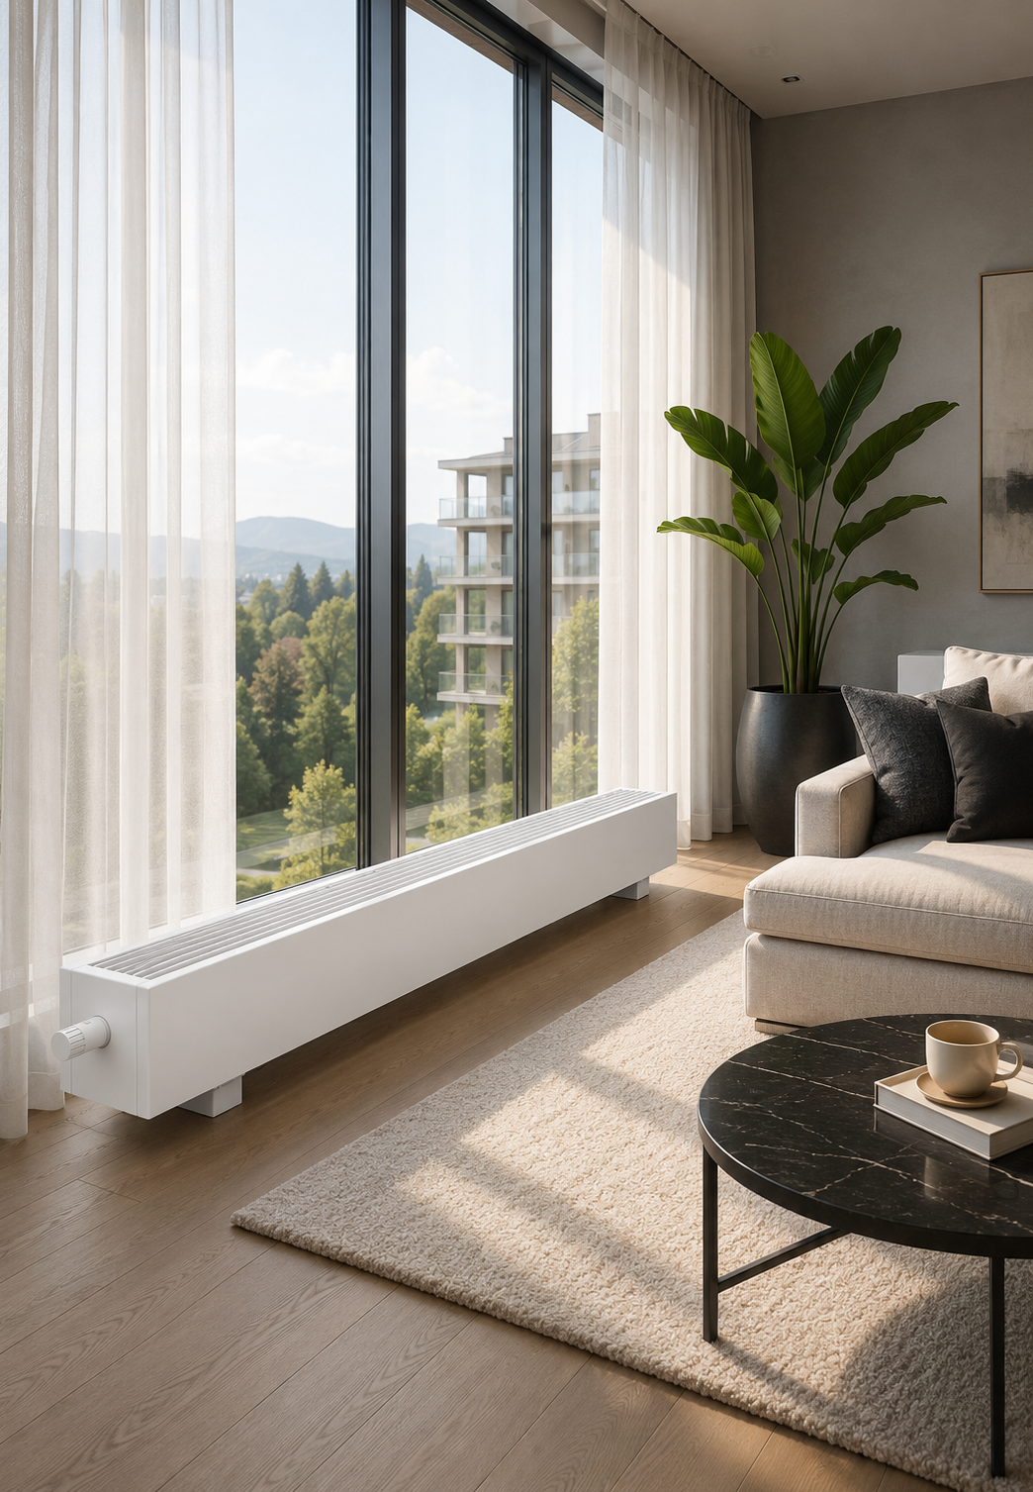
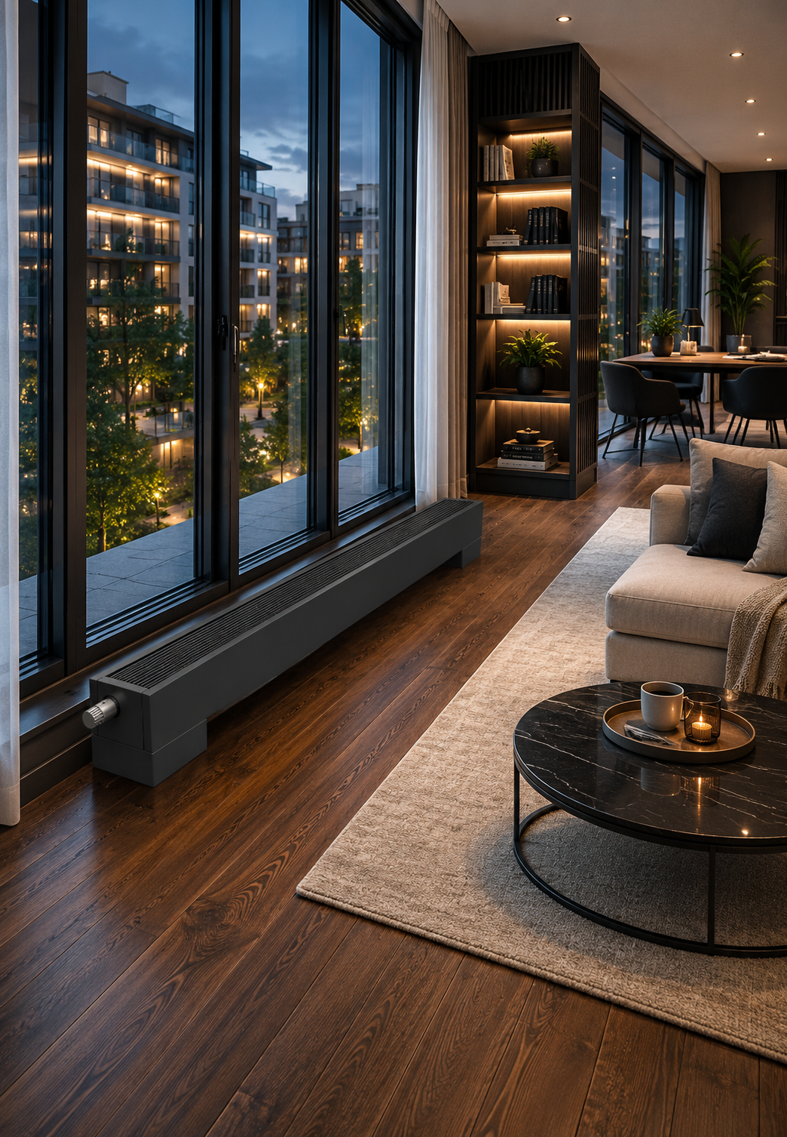






SC
CLASSIC DESIGN
SC-H
MODERN DESIGN
WHEN TO CHOOSE SC ?
WHEN TO CHOOSE SC-H ?
Residential houses
Perfect for flats, houses
and apartments
Modern interiors
Created for contemporary architecture and a modern lifestyle
Classic interiors
Harmoniously matches traditional and timeless architecture
Premium segment
Suitable for high-class interiors and exclusive projects
Versatile projects
A reliable and functional solution for every project
Architectural projects Becomes part of the interior and emphasises its character.
FREESTANDING CONVECTORS SC | 05

Slide 6
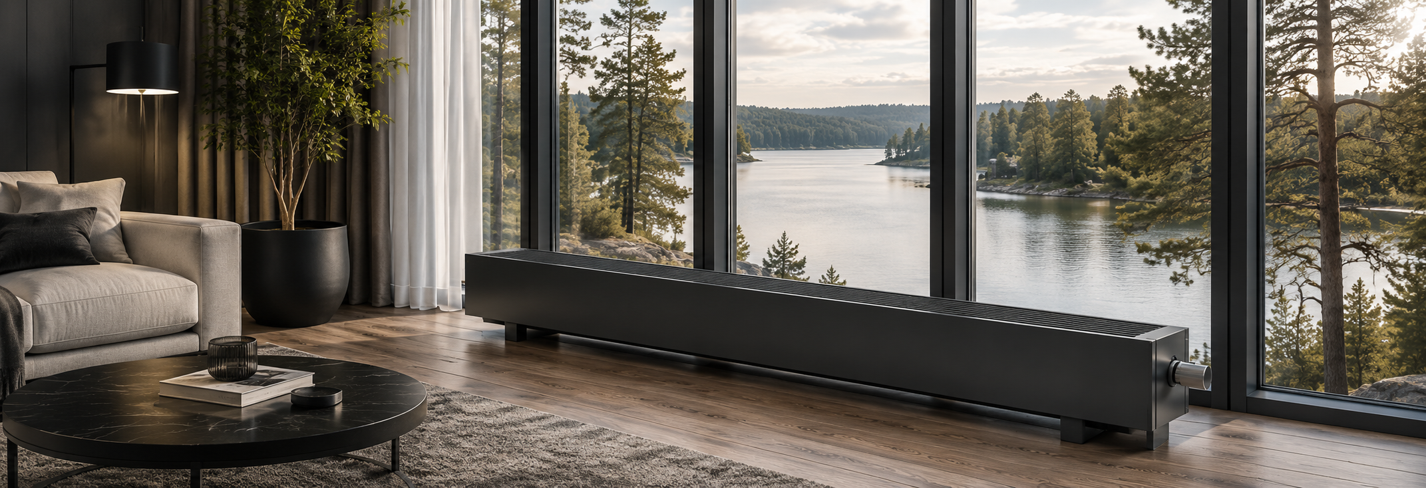




KEY ADVANTAGES
Why choose SC / SC-H convectors?
NO NOISE
NO ELECTRICITY
NATURAL CONVECTION
FAST RESPONSE
Quiet heat transfer - comfort without disturbance
Works without electricity or electronics - reliable and durable
Heat is distributed naturally, efficiently
and evenly
Reacts quickly to temperature changes and ensures comfort
EASY INSTALLATION
LOW SURFACE TEMPERATURE
HIGH WORKING PRESSURE
The simple construction allows fast and easy installation
Safe surface - no risk of burns
Suitable for high pressure
systems
EN 442 CERTIFICATION
DURABILITY
7-YEAR WARRANTY
Meets the strict requirements of the European standard EN 442
High-quality materials ensure a long service life
Reliability confirmed
by a long warranty for heat exchanger
A RELIABLE SOLUTION FOR THE LONG TERM.
SC and SC-H convectors are designed to deliver reliable, safe and efficient heating for many years. Quality you will feel every day.
06 | FREESTANDING CONVECTORS SC

Slide 7
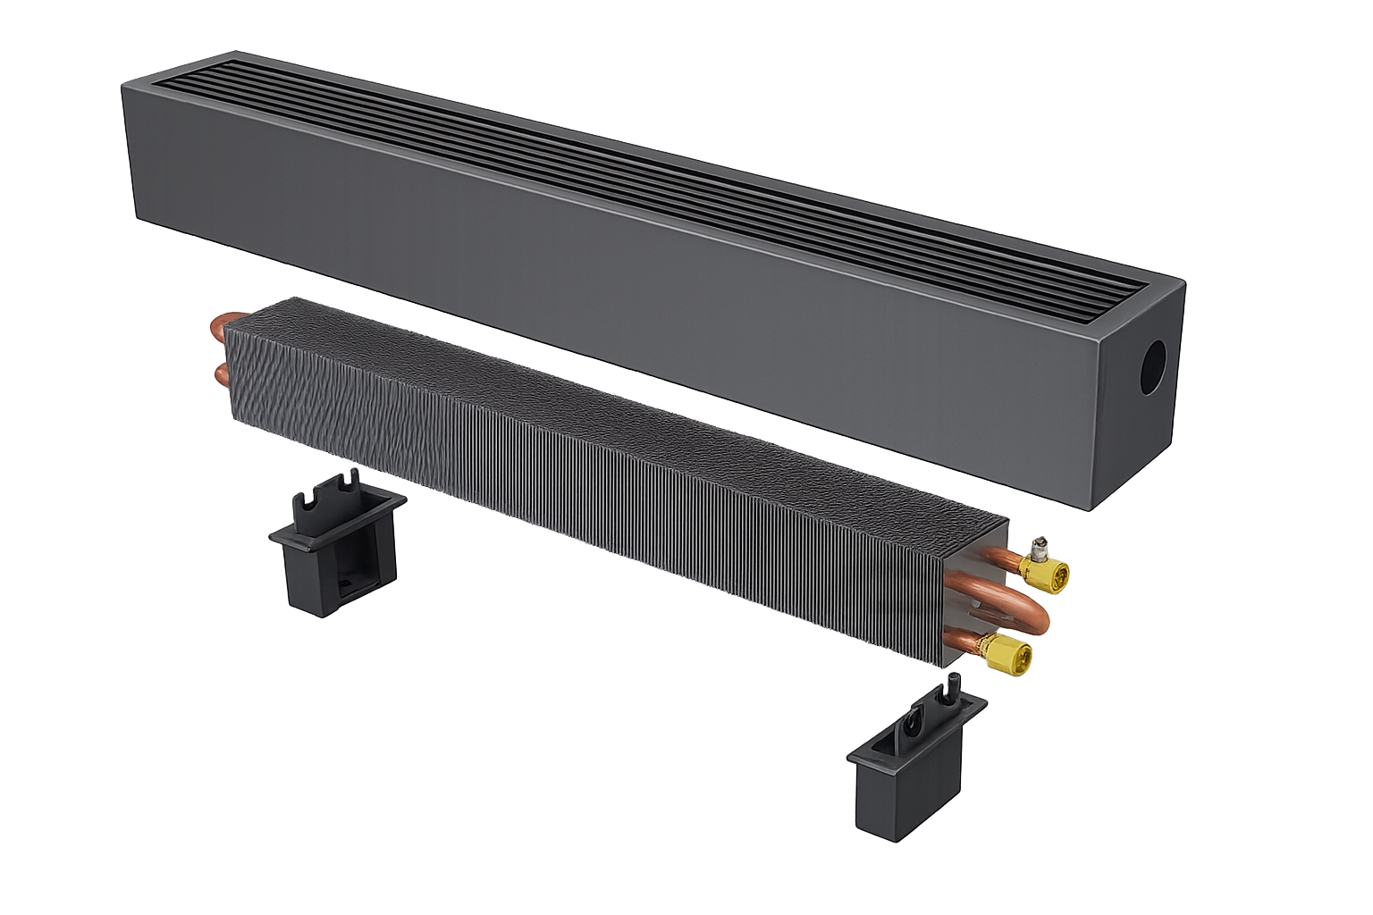
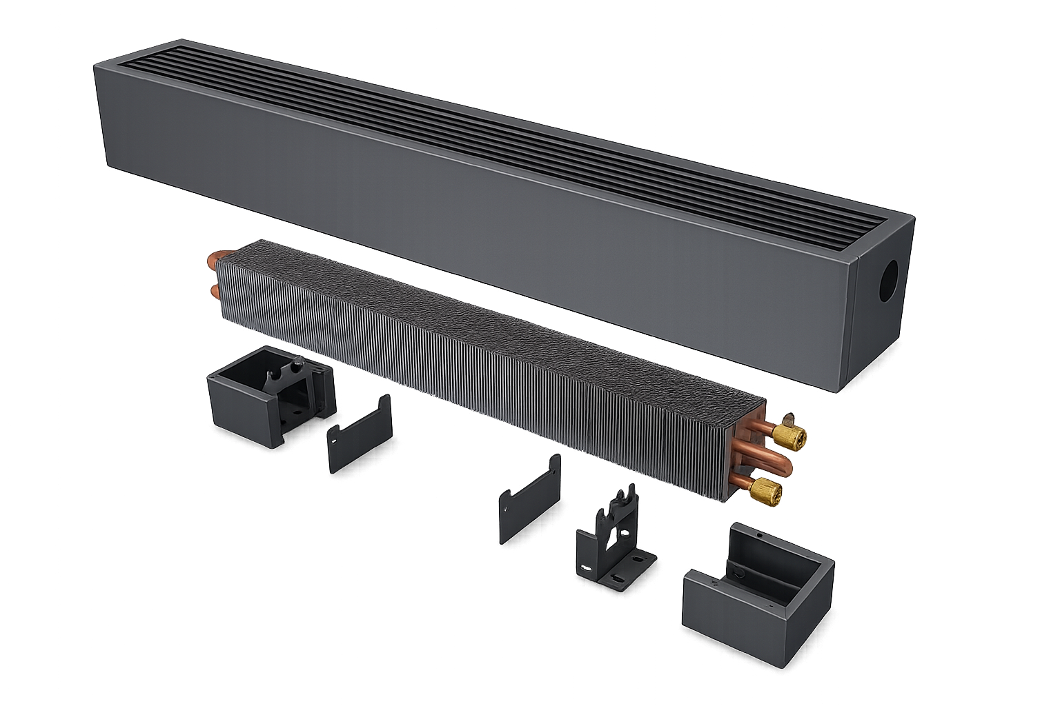

CONSTRUCTION AND MATERIALS
High-quality materials.
Reliable construction.
SC
CLASSIC DESIGN
SC-H
MODERN DESIGN
1
1
4
6
5
5
7
3
3
4
2
2
1
Steel casing, powder-coated
1
Steel casing, powder-coated
2
Steel feet, powder-coated
2
Steel feet, powder-coated
3
Heat exchanger protection –
fixing elements
3
Steel heat exchanger holders,
powder-coated
4
Copper - aluminium heat exchanger
4
Feet covers
5
Air vent
5
Heat exchanger protection –
fixing elements
6
Copper-aluminium heat exchanger
7
Air vent
STEEL CASING
COPPER-ALUMINIUM
HEAT EXCHANGER
POWDER COATING
FIXING SYSTEM
A sturdy steel casing, powder-coated, ensures long-lasting durability
High-quality copper tubes and profiled aluminium fins ensure efficient heat transfer
Scratch- and corrosion-resistant powder coating preserves the aesthetic appearance for many years
Sturdy feet and fixing elements ensure stable installation and reliable operation
FREESTANDING CONVECTORS SC | 07

Slide 8
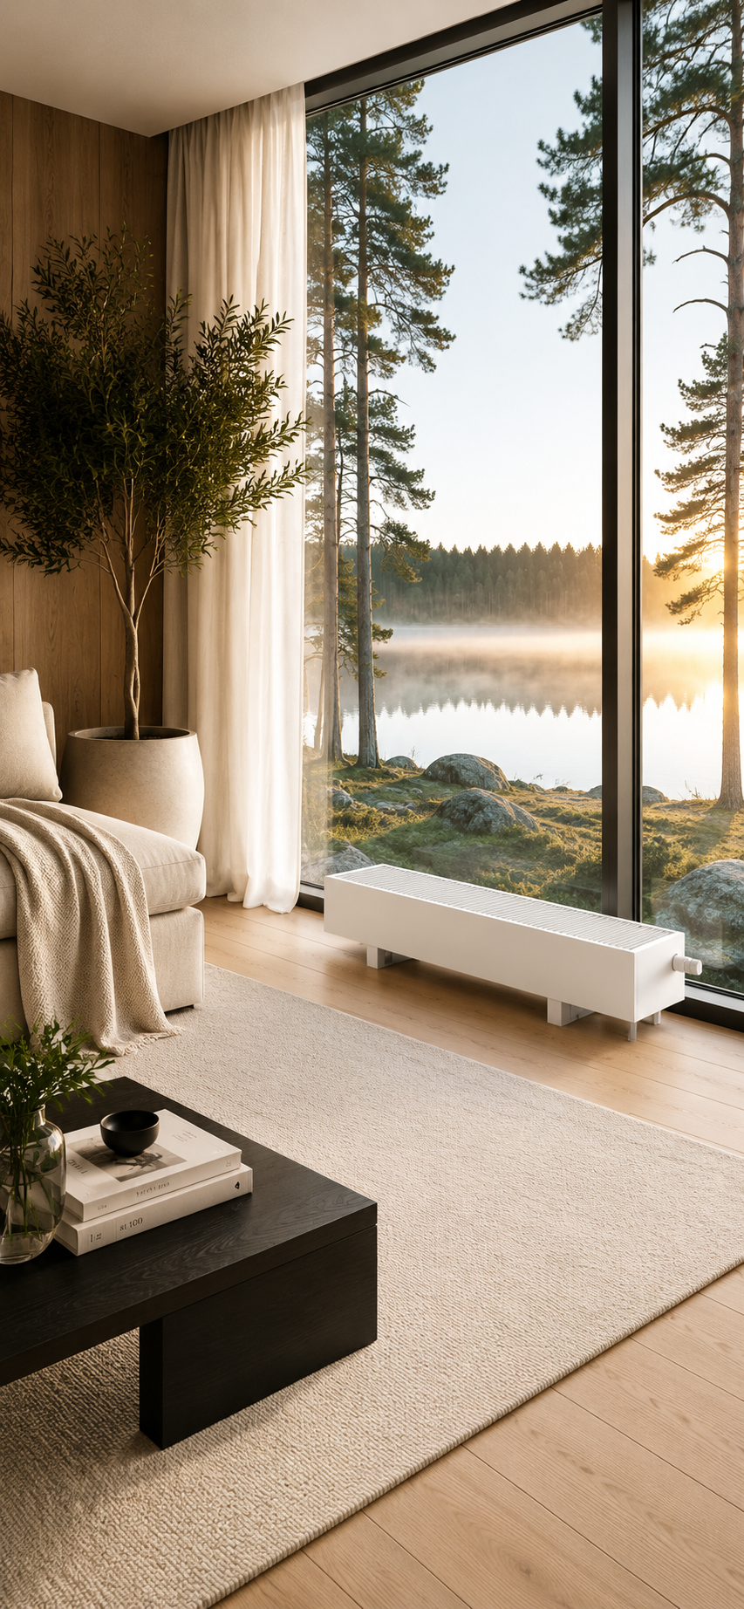
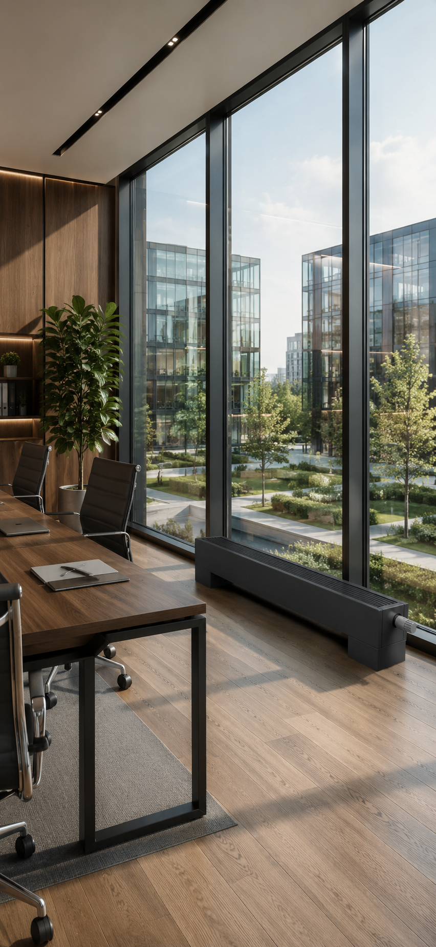
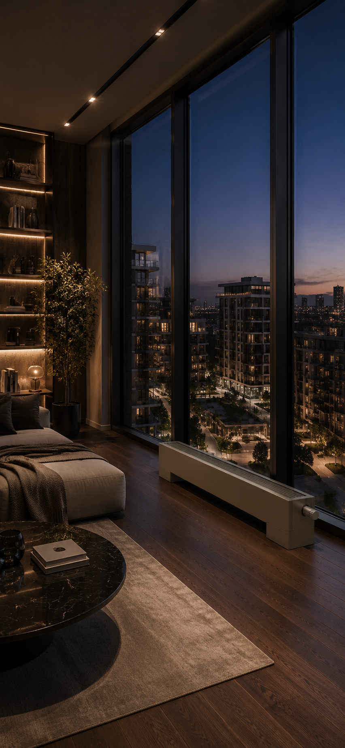
DESIGN OPTIONS
A convector that adapts to your architecture
MODERN HOME
Clean lines, bright spaces and natural comfort
OFFICE
Discreet design, efficient heating and everyday convenience
PREMIUM INTERIOR
Exclusive materials, a luxurious feel and the highest quality
STANDARD COLOUR
WHITE
RAL 9016
CUSTOM COLOURS ON REQUEST
Painting in any RAL colour is possible.
RAL 7016 Anthracite Grey
RAL 9005
Jet Black
RAL 7024 Graphite Grey
RAL 7044
Silk Grey
RAL 7006
Beige Grey
RAL 1035
Pearl Beige
RAL of choice
UNLIMITED
DESIGN OPTIONS
SUITABLE FOR ALL TYPES OF INTERIORS
QUALITY AND
DURABILITY
A wide colour palette allows a perfect match with any interior style
For modern homes, offices, hotels and commercial spaces
High-quality powder
coating ensures durability and longevity
08 | FREESTANDING CONVECTORS SC

Slide 9
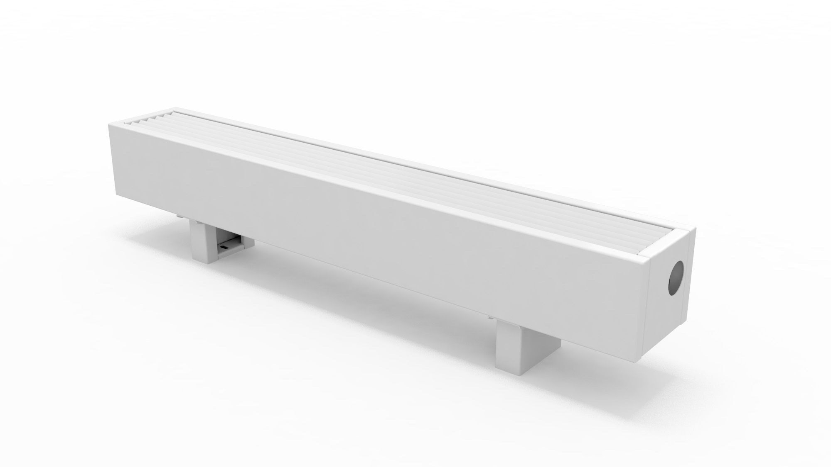
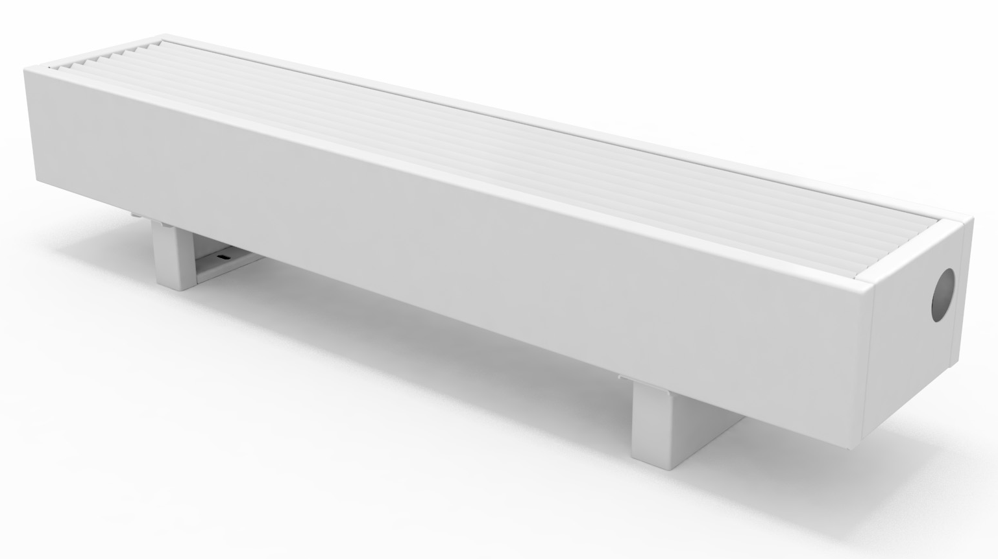
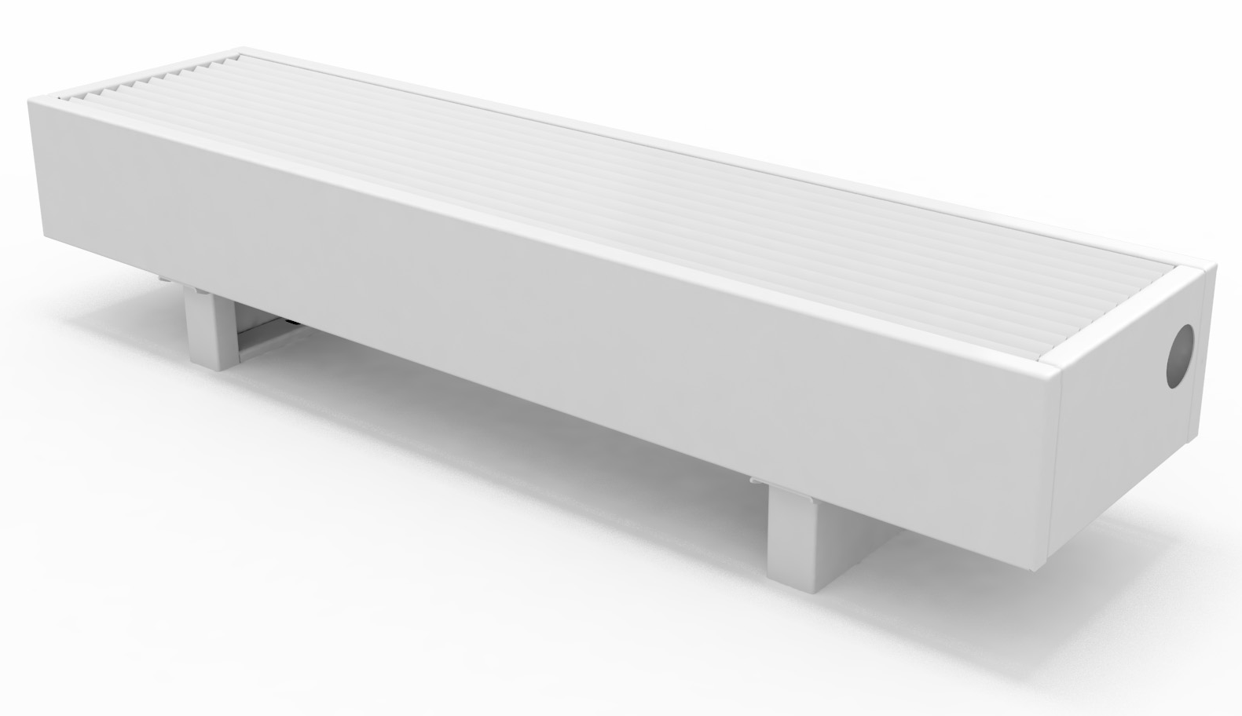
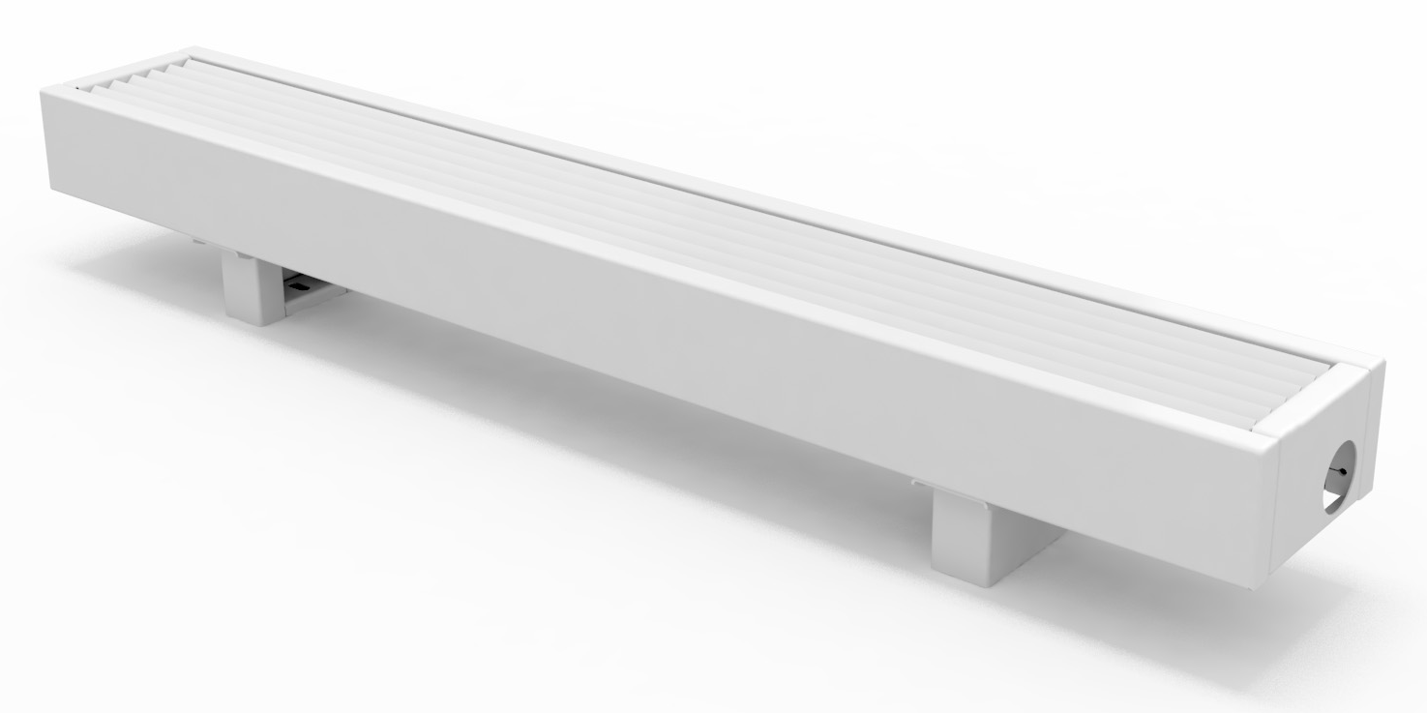
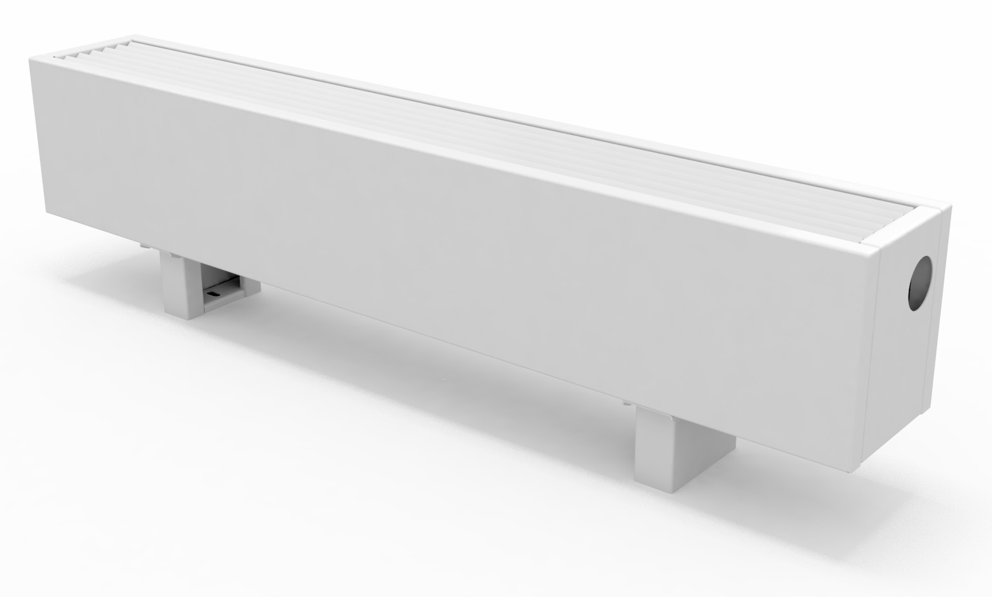
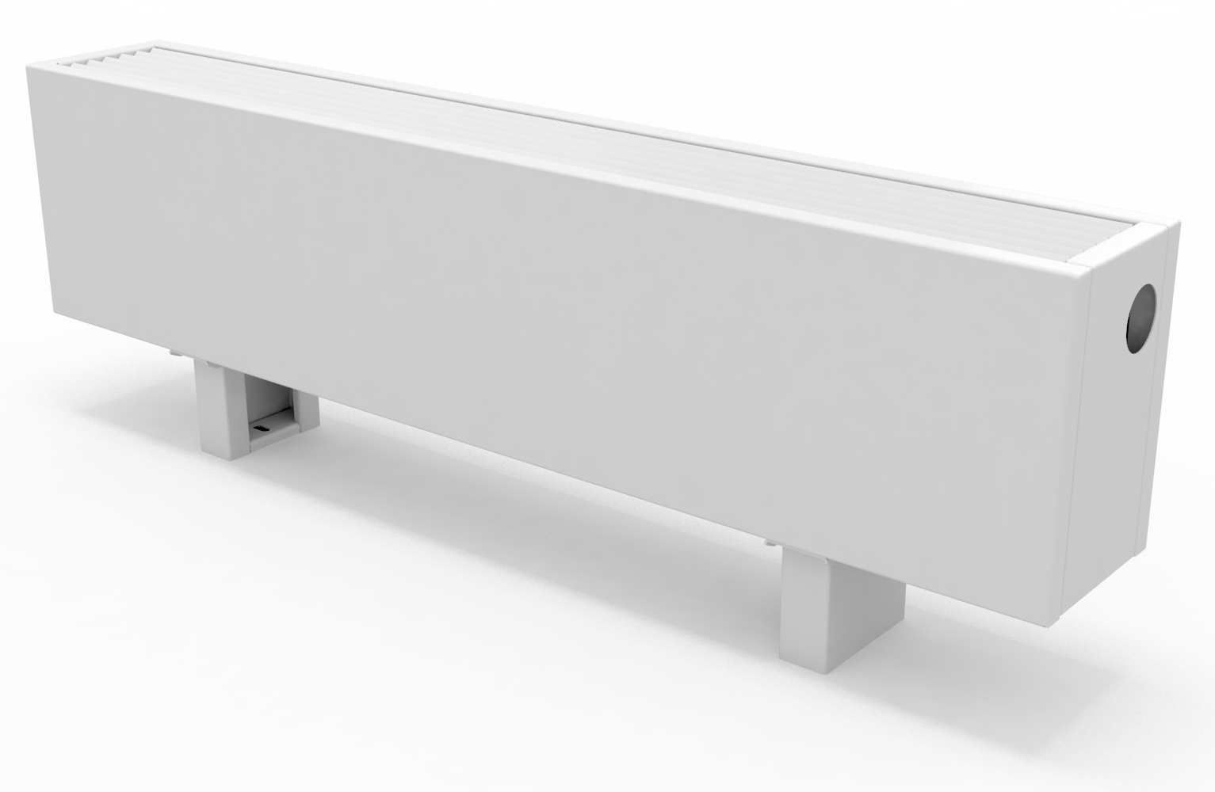

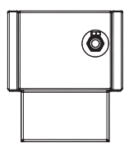
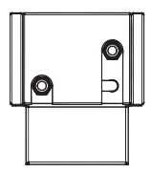
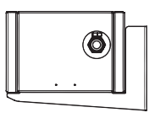
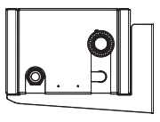
MODELS, DIMENSIONS AND OUTPUTS
SC and SC-H models are manufactured in 288 width, height and length versions, so they can be adapted to the requirements of the most varied projects
WIDTHS
14 cm
19 cm
24 cm
Compact
Versatile
Powerful
HEIGHTS
14,5 cm (SC)
15,0 cm (SC-H)
21,5 cm
26,5 cm
33,0 cm
Low profile
Standard
Increased output
Maximum output
WIDTH
HEIGHT
LENGTH
14 / 19 / 24 cm
14,5-15,0 / 21,5 / 26,5 / 33,0 cm
60 - 290 cm (every 10 cm)
CONSTRUCTION AND CONNECTION OPTIONS
SC
SC-S
SC-W
SC-WS
Mounting:
floor
Connections:
bottom
Mounting:
floor
Connections:
end
Mounting:
wall
Connections:
bottom
Mounting:
wall
Connections:
end
FREESTANDING CONVECTORS SC | 09

Slide 10

MODELS, DIMENSIONS AND OUTPUTS
THERMAL OUTPUT (W) AT 75/65/20°C EN 442
Width (cm) | Height (cm) | Length (cm)
 |  | 60 | 70 | 80 | 90 | 100 | 110 | 120 | 130 | 140 | 150 | 160 | 170 | 180 | 190 | 200 | 210 | 220 | 230 | 240 | 250 | 260 | 270 | 280 | 290
14 | 14,5/15,0 | 178 | 223 | 269 | 314 | 359 | 404 | 449 | 494 | 539 | 585 | 630 | 675 | 720 | 765 | 810 | 855 | 901 | 946 | 991 | 1036 | 1081 | 1126 | 1171 | 1217
 | 21,5 | 272 | 341 | 410 | 479 | 548 | 617 | 686 | 755 | 824 | 893 | 962 | 1031 | 1100 | 1169 | 1238 | 1307 | 1376 | 1445 | 1514 | 1583 | 1652 | 1721 | 1790 | 1859
 | 26,5 | 324 | 407 | 489 | 571 | 653 | 735 | 817 | 900 | 982 | 1064 | 1146 | 1228 | 1310 | 1392 | 1475 | 1557 | 1639 | 1721 | 1803 | 1885 | 1968 | 2050 | 2132 | 2214
 | 33,0 | 377 | 472 | 567 | 663 | 758 | 853 | 948 | 1044 | 1139 | 1234 | 1330 | 1425 | 1520 | 1616 | 1711 | 1806 | 1902 | 1997 | 2092 | 2188 | 2283 | 2378 | 2474 | 2569
19 | 14,5/15,0 | 267 | 335 | 403 | 471 | 538 | 606 | 674 | 741 | 809 | 877 | 945 | 1012 | 1080 | 1148 | 1215 | 1283 | 1351 | 1419 | 1486 | 1554 | 1622 | 1689 | 1757 | 1825
 | 21,5 | 409 | 512 | 616 | 719 | 823 | 926 | 1029 | 1133 | 1236 | 1340 | 1443 | 1547 | 1650 | 1754 | 1857 | 1961 | 2064 | 2168 | 2271 | 2374 | 2478 | 2581 | 2685 | 2788
 | 26,5 | 487 | 610 | 733 | 856 | 980 | 1103 | 1226 | 1349 | 1473 | 1596 | 1719 | 1842 | 1965 | 2089 | 2212 | 2335 | 2458 | 2582 | 2705 | 2828 | 2951 | 3074 | 3198 | 3321
 | 33,0 | 562 | 704 | 846 | 988 | 1130 | 1273 | 1415 | 1557 | 1699 | 1841 | 1984 | 2126 | 2268 | 2410 | 2552 | 2695 | 2837 | 2979 | 3121 | 3263 | 3406 | 3548 | 3690 | 3832
24 | 14,5/15,0 | 373 | 467 | 562 | 656 | 750 | 845 | 939 | 1034 | 1128 | 1222 | 1317 | 1411 | 1505 | 1600 | 1694 | 1789 | 1883 | 1977 | 2072 | 2166 | 2261 | 2355 | 2449 | 2544
 | 21,5 | 571 | 715 | 860 | 1004 | 1148 | 1293 | 1437 | 1582 | 1726 | 1871 | 2015 | 2160 | 2304 | 2448 | 2593 | 2737 | 2882 | 3026 | 3171 | 3315 | 3460 | 3604 | 3749 | 3893
 | 26,5 | 659 | 825 | 992 | 1159 | 1326 | 1492 | 1659 | 1826 | 1993 | 2160 | 2326 | 2493 | 2660 | 2827 | 2993 | 3160 | 3327 | 3494 | 3660 | 3827 | 3994 | 4161 | 4327 | 4494
 | 33,0 | 747 | 936 | 1125 | 1314 | 1503 | 1692 | 1881 | 2070 | 2259 | 2448 | 2637 | 2827 | 3016 | 3205 | 3394 | 3583 | 3772 | 3961 | 4150 | 4339 | 4528 | 4717 | 4906 | 5095
THERMAL OUTPUT (W) AT 65/55/20°C EN 442
Width (cm) | Height (cm) | Length (cm)
 |  | 60 | 70 | 80 | 90 | 100 | 110 | 120 | 130 | 140 | 150 | 160 | 170 | 180 | 190 | 200 | 210 | 220 | 230 | 240 | 250 | 260 | 270 | 280 | 290
14 | 14,5/15,0 | 130 | 163 | 196 | 229 | 261 | 294 | 327 | 360 | 393 | 426 | 459 | 492 | 525 | 557 | 590 | 623 | 656 | 689 | 722 | 755 | 788 | 821 | 854 | 886
 | 21,5 | 197 | 246 | 296 | 346 | 396 | 446 | 495 | 545 | 595 | 645 | 695 | 744 | 794 | 844 | 894 | 943 | 993 | 1043 | 1093 | 1143 | 1192 | 1242 | 1292 | 1342
 | 26,5 | 234 | 293 | 353 | 412 | 471 | 530 | 590 | 649 | 708 | 767 | 827 | 886 | 945 | 1004 | 1064 | 1123 | 1182 | 1241 | 1300 | 1360 | 1419 | 1478 | 1537 | 1597
 | 33,0 | 271 | 340 | 409 | 478 | 546 | 615 | 684 | 752 | 821 | 890 | 958 | 1027 | 1096 | 1165 | 1233 | 1302 | 1371 | 1439 | 1508 | 1577 | 1646 | 1714 | 1783 | 1852
19 | 14,5/15,0 | 195 | 244 | 294 | 343 | 392 | 442 | 491 | 540 | 590 | 639 | 688 | 738 | 787 | 836 | 886 | 935 | 984 | 1034 | 1083 | 1132 | 1182 | 1231 | 1280 | 1330
 | 21,5 | 295 | 370 | 444 | 519 | 594 | 668 | 743 | 818 | 892 | 967 | 1042 | 1116 | 1191 | 1266 | 1341 | 1415 | 1490 | 1565 | 1639 | 1714 | 1789 | 1863 | 1938 | 2013
 | 26,5 | 351 | 440 | 529 | 618 | 707 | 795 | 884 | 973 | 1062 | 1151 | 1240 | 1329 | 1418 | 1506 | 1595 | 1684 | 1773 | 1862 | 1951 | 2040 | 2128 | 2217 | 2306 | 2395
 | 33,0 | 402 | 504 | 606 | 708 | 809 | 911 | 1013 | 1115 | 1217 | 1318 | 1420 | 1522 | 1624 | 1726 | 1827 | 1929 | 2031 | 2133 | 2235 | 2336 | 2438 | 2540 | 2642 | 2744
24 | 14,5/15,0 | 274 | 344 | 413 | 483 | 552 | 622 | 691 | 761 | 830 | 899 | 969 | 1038 | 1108 | 1177 | 1247 | 1316 | 1386 | 1455 | 1525 | 1594 | 1664 | 1733 | 1802 | 1872
 | 21,5 | 410 | 514 | 618 | 722 | 826 | 930 | 1034 | 1138 | 1241 | 1345 | 1449 | 1553 | 1657 | 1761 | 1865 | 1969 | 2073 | 2176 | 2280 | 2384 | 2488 | 2592 | 2696 | 2800
 | 26,5 | 472 | 591 | 710 | 830 | 949 | 1069 | 1188 | 1307 | 1427 | 1546 | 1666 | 1785 | 1904 | 2024 | 2143 | 2263 | 2382 | 2501 | 2621 | 2740 | 2860 | 2979 | 3098 | 3218
 | 33,0 | 533 | 668 | 803 | 938 | 1072 | 1207 | 1342 | 1477 | 1612 | 1747 | 1882 | 2017 | 2152 | 2287 | 2422 | 2556 | 2691 | 2826 | 2961 | 3096 | 3231 | 3366 | 3501 | 3636
THERMAL OUTPUT (W) AT 55/45/20°C EN 442
Width (cm) | Height (cm) | Length (cm)
 |  | 60 | 70 | 80 | 90 | 100 | 110 | 120 | 130 | 140 | 150 | 160 | 170 | 180 | 190 | 200 | 210 | 220 | 230 | 240 | 250 | 260 | 270 | 280 | 290
14 | 14,5/15,0 | 86 | 108 | 130 | 152 | 174 | 196 | 218 | 239 | 261 | 283 | 305 | 327 | 349 | 371 | 393 | 414 | 436 | 458 | 480 | 502 | 524 | 546 | 567 | 589
 | 21,5 | 129 | 162 | 195 | 227 | 260 | 293 | 325 | 358 | 391 | 423 | 456 | 489 | 522 | 554 | 587 | 620 | 652 | 685 | 718 | 750 | 783 | 816 | 849 | 881
 | 26,5 | 154 | 192 | 231 | 270 | 309 | 348 | 387 | 426 | 465 | 503 | 542 | 581 | 620 | 659 | 698 | 737 | 776 | 814 | 853 | 892 | 931 | 970 | 1009 | 1048
 | 33,0 | 178 | 223 | 268 | 313 | 358 | 403 | 448 | 493 | 538 | 583 | 628 | 673 | 718 | 764 | 809 | 854 | 899 | 944 | 989 | 1034 | 1079 | 1124 | 1169 | 1214
19 | 14,5/15,0 | 130 | 162 | 195 | 228 | 261 | 294 | 326 | 359 | 392 | 425 | 458 | 490 | 523 | 556 | 589 | 622 | 654 | 687 | 720 | 753 | 786 | 818 | 851 | 884
 | 21,5 | 194 | 243 | 292 | 341 | 390 | 439 | 488 | 537 | 586 | 635 | 684 | 733 | 782 | 831 | 881 | 930 | 979 | 1028 | 1077 | 1126 | 1175 | 1224 | 1273 | 1322
 | 26,5 | 230 | 289 | 347 | 405 | 464 | 522 | 580 | 639 | 697 | 755 | 813 | 872 | 930 | 988 | 1047 | 1105 | 1163 | 1222 | 1280 | 1338 | 1397 | 1455 | 1513 | 1572
 | 33,0 | 261 | 328 | 394 | 460 | 526 | 592 | 658 | 725 | 791 | 857 | 923 | 989 | 1056 | 1122 | 1188 | 1254 | 1320 | 1386 | 1453 | 1519 | 1585 | 1651 | 1717 | 1783
24 | 14,5/15,0 | 185 | 232 | 278 | 325 | 372 | 419 | 465 | 512 | 559 | 606 | 653 | 699 | 746 | 793 | 840 | 886 | 933 | 980 | 1027 | 1074 | 1120 | 1167 | 1214 | 1261
 | 21,5 | 268 | 336 | 404 | 472 | 540 | 608 | 676 | 744 | 812 | 880 | 947 | 1015 | 1083 | 1151 | 1219 | 1287 | 1355 | 1423 | 1491 | 1559 | 1627 | 1695 | 1762 | 1830
 | 26,5 | 307 | 384 | 462 | 539 | 617 | 695 | 772 | 850 | 927 | 1005 | 1083 | 1160 | 1238 | 1316 | 1393 | 1471 | 1548 | 1626 | 1704 | 1781 | 1859 | 1936 | 2014 | 2092
 | 33,0 | 345 | 432 | 519 | 607 | 694 | 781 | 869 | 956 | 1043 | 1131 | 1218 | 1305 | 1393 | 1480 | 1567 | 1654 | 1742 | 1829 | 1916 | 2004 | 2091 | 2178 | 2266 | 2353
Thermal outputs at non-standard temperatures are given at konveka.com:
https://konveka.com/product/trench-heaters/pastatomi-konvektoriai-sc/
https://konveka.com/product/trench-heaters/pastatomi-konvektoriai-sc-h/
10 | FREESTANDING CONVECTORS SC

Slide 11
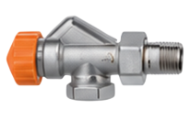

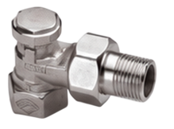

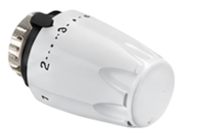
MAXIMUM WATER FLOW AND PRESSURE LOSS
Width, cm | Height, cm | Max. water flow, l/h | Pressure loss calculation formula, Pa
14 | 14,5 (SC) 15,0 (SC-H) | 122 | (L - 0,20) x (0,0074 x q² - 0,0501 x q + 0,0796)
 | 21,5 | 190 | (L - 0,20) x (0,0078 x q² + 1,3090 x q - 20,440)
 | 26,5 | 226 | (L - 0,20) x (0,0111 x q² + 2,2429 x q - 58,220)
 | 33,0 | 246 | (L - 0,20) x (0,0157 x q² + 2,6179 x q - 40,880)
19 | 14,5 (SC) 15,0 (SC-H) | 171 | (L - 0,24) x (0,0022 x q² + 0,3040 x q + 4,120)
 | 21,5 | 265 | (L - 0,20) x (0,0111 x q² + 2,2429 x q - 58,220)
 | 26,5 | 316 | (L - 0,24) x (0,0084 x q² + 0,5728 x q + 14,976)
 | 33,0 | 344 | (L - 0,20) x (0,0301 x q² + 1,8654 x q + 5,7952)
24 | 14,5 (SC) 15,0 (SC-H) | 239 | (L - 0,20) x (0,0078 x q² + 1,3090 x q - 20,440)
 | 21,5 | 371 | (L - 0,20) x (0,0157 x q² + 2,6179 x q - 40,880)
 | 26,5 | 442 | (L - 0,20) x (0,0301 x q² + 1,8654 x q + 5,7952)
 | 33,0 | 481 | (L - 0,20) x (0,0313 x q² + 5,2215 x q - 78,190)
ACCESSORIES
Correctly selected accessories ensure convenient installation,
precise temperature regulation and smooth system operation
01
THERMOSTATIC VALVE (AXIAL)
TVA15
02
RETURN FLOW LIMITER (ANGLE)
LA15
Working temperature -10°C -120°C
Working temperature -10°C -120°C
Thread 1/2"
Thread 1/2"
Pressure class - PN10
Pressure class - PN10
Kvs
Kvs - 2,0
Kvs
Kvs – 2,0
Ni
Body – nickel-
plated bronze
Ni
Body – nickel-
plated bronze
03
THERMOSTATIC HEAD
TH
Temperature range
6°C - 28°C
Connection thread M30 x 1.5mm
Max. temperature limiting
Frost protection
ABS
Casing material
ABS
FREESTANDING CONVECTORS SC | 11

Slide 12
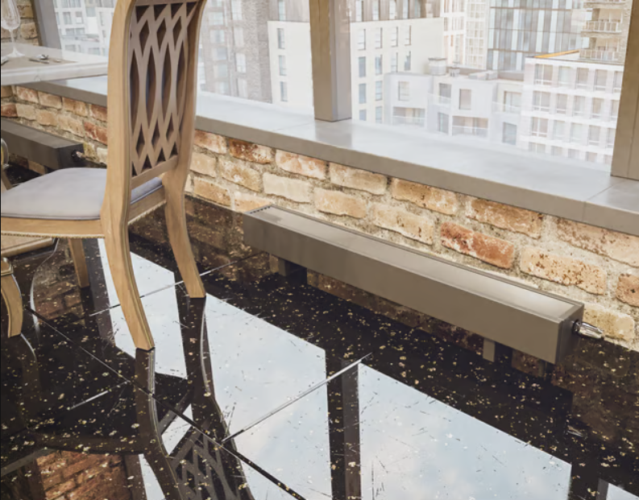

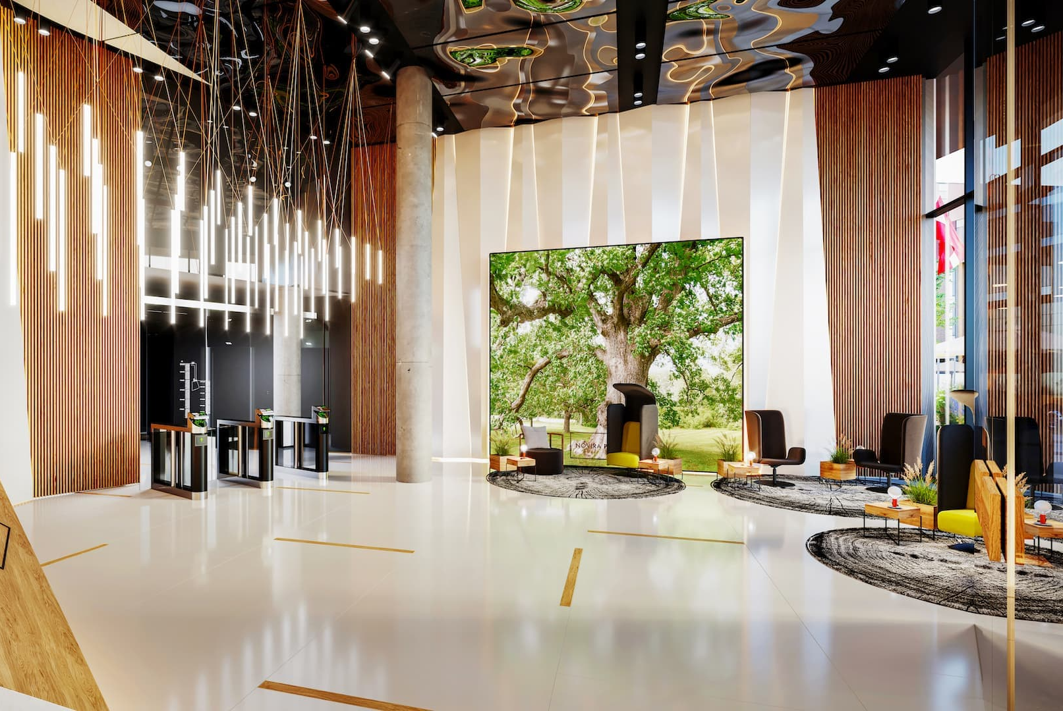
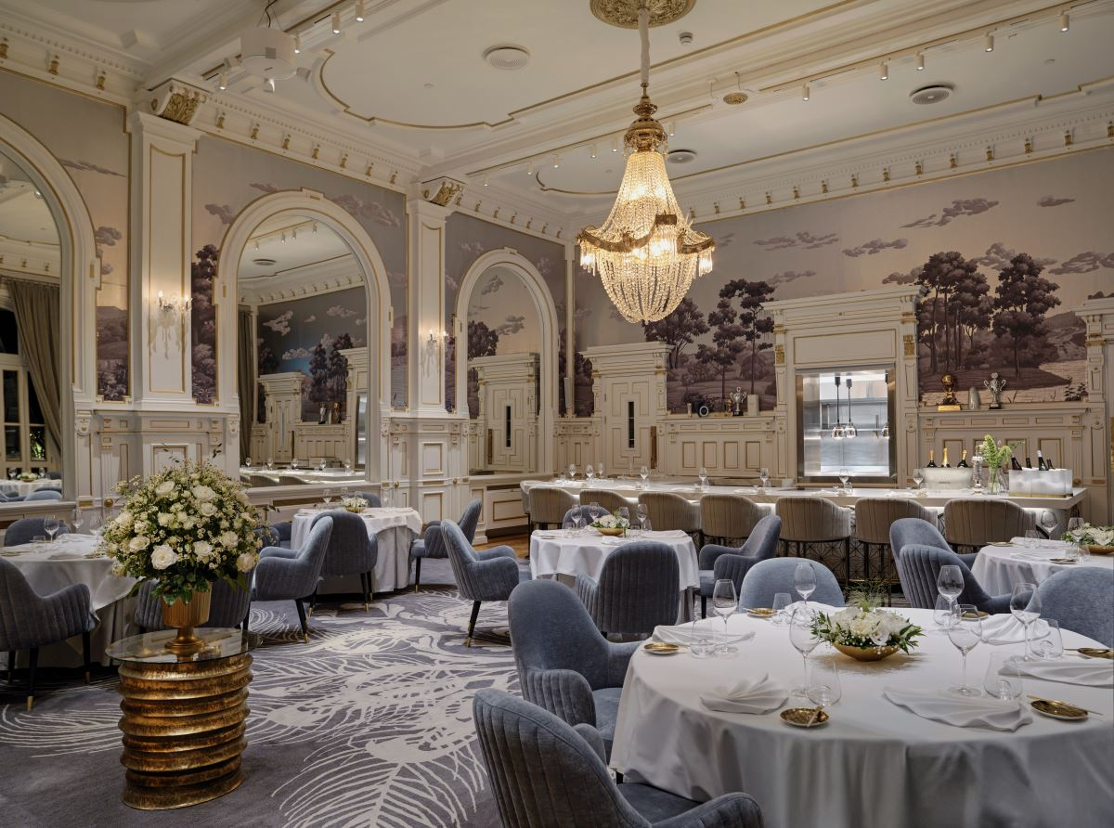
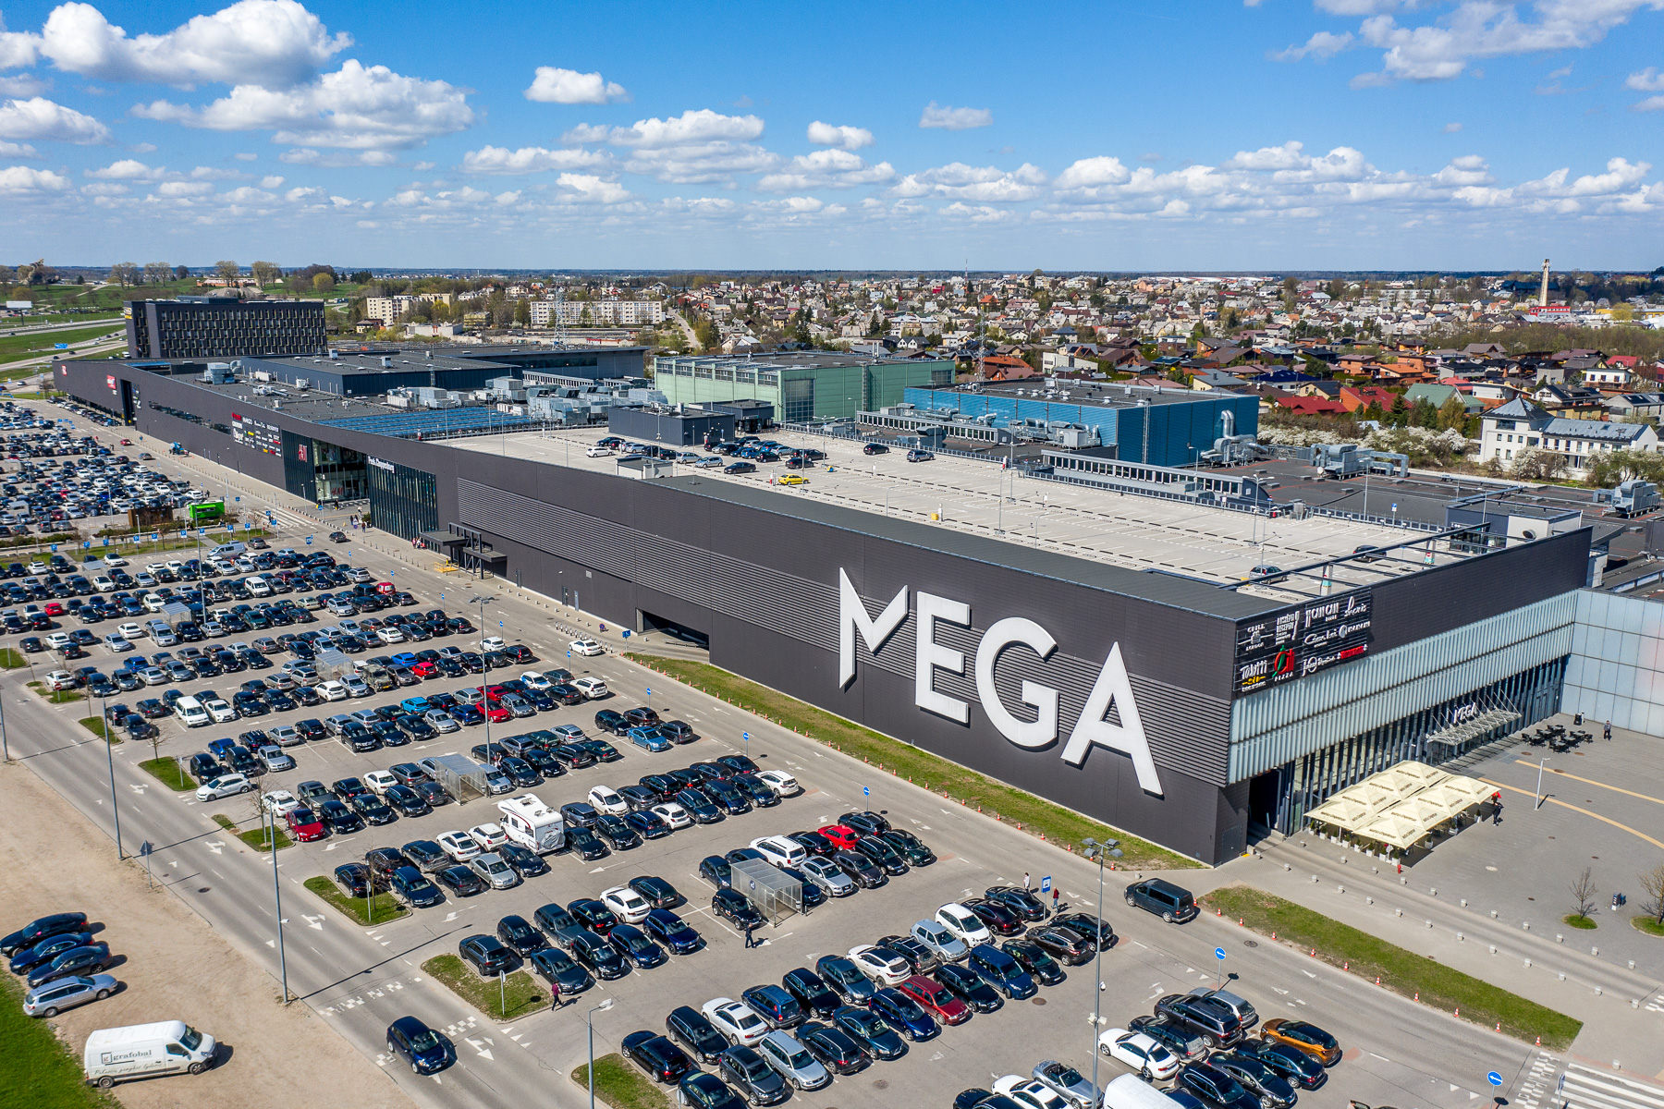
REAL PROJECTS
KONVEKA convectors are chosen in prestigious buildings worldwide, where comfort, reliability and architectural aesthetics matter most
VILNIUS, LITHUANIA
ADMINISTRATIVE BUILDING
Application
Offices
Product
SC
Colour
RAL 8025
BUSINESS CENTRE
RIGA, LATVIA
HOTEL "BRITANNIA"
TRONDHEIM, NORWAY
SHOPPING CENTRE „MEGA“
KAUNAS, LITHUANIA
Application
Business centre
Application
Hotel
Application
Shopping centre
Product
SC
Product
SC
Product
SC-H
Grilles
Painted metal
Grilles
Painted metal
Grilles
Painted metal
12 | FREESTANDING CONVECTORS SC

Slide 13
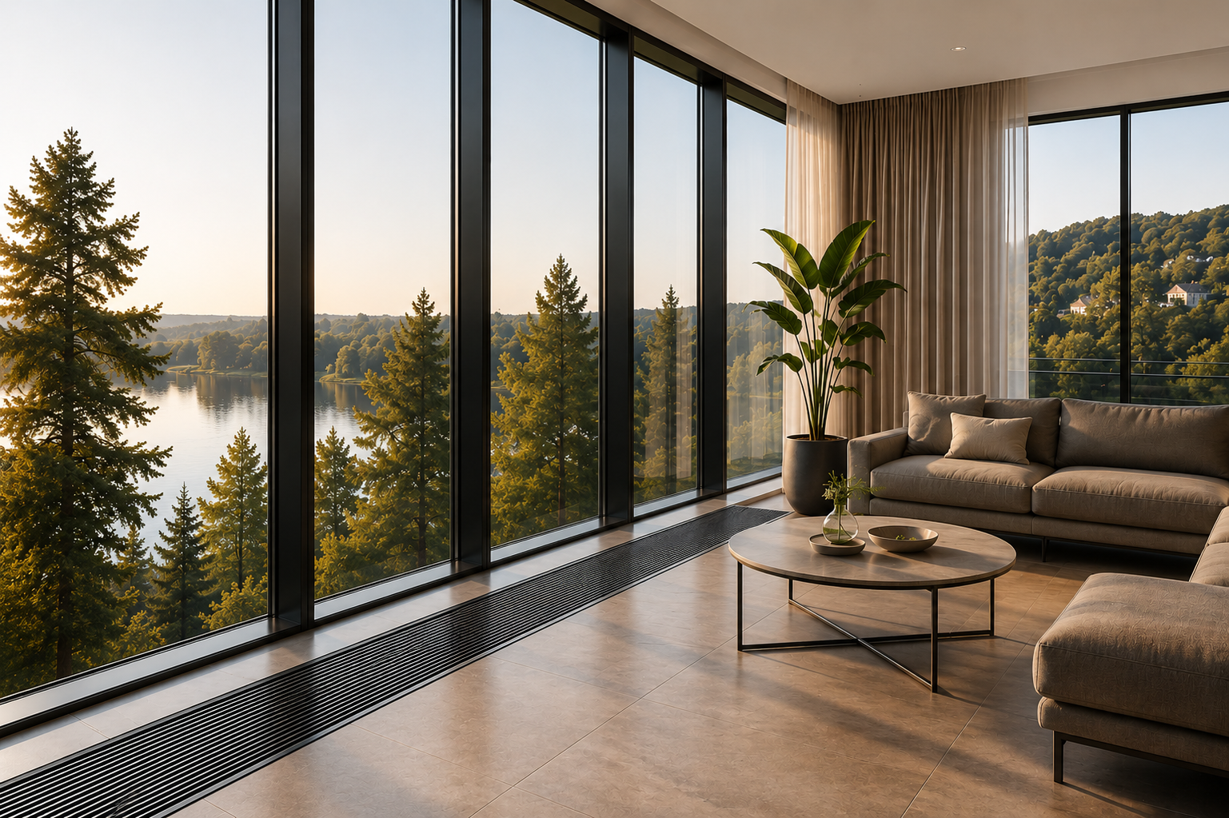








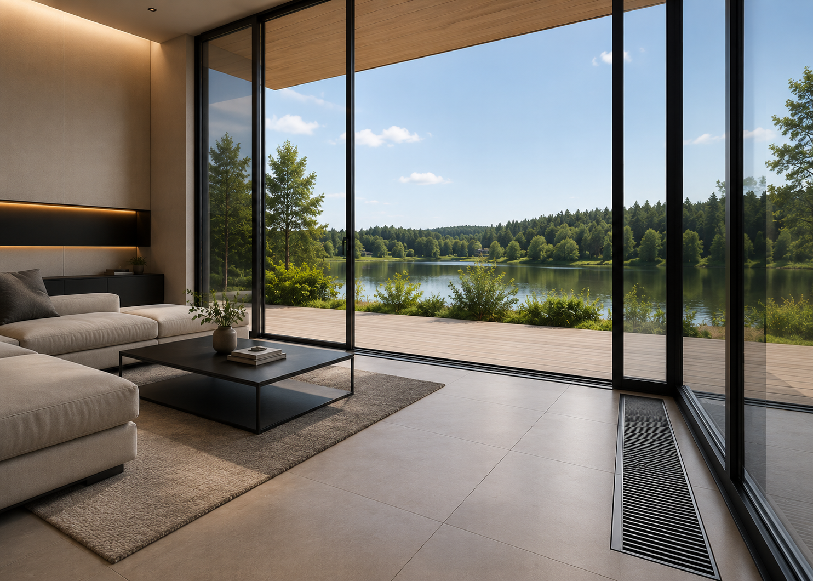
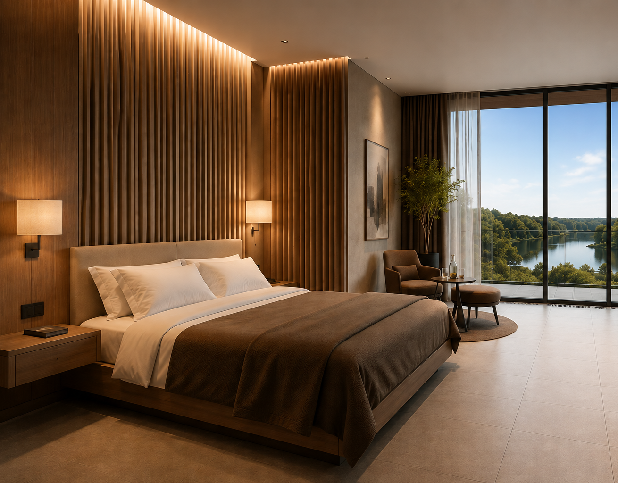
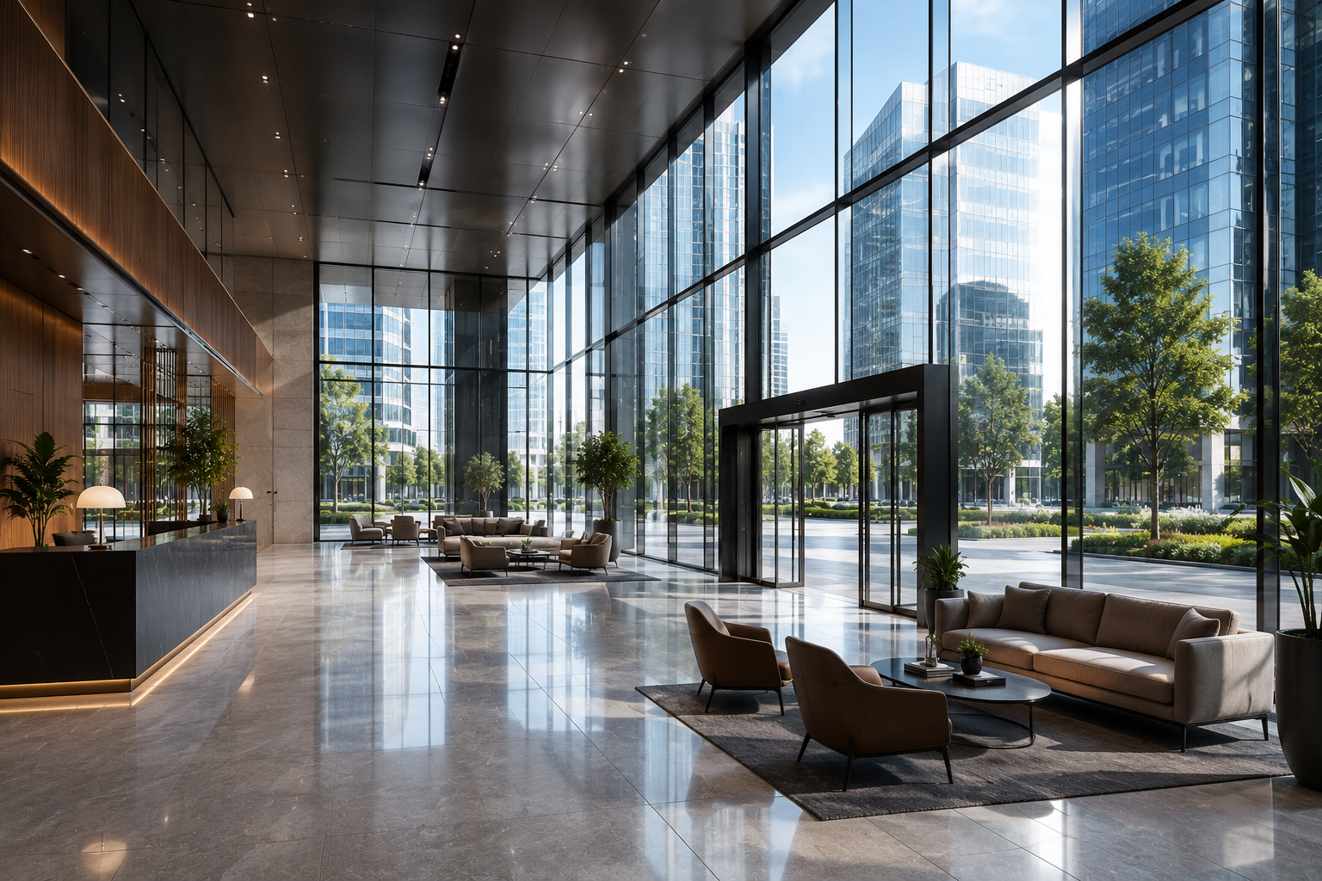
ABOUT KONVEKA
KONVEKA is a Lithuanian engineering company that has been creating top-quality convectors and fan coils for contemporary architecture for more than 20 years.
Our solutions combine efficiency, reliability and aesthetics - so that buildings are not only functional but also inspiring
20+
YEARS OF EXPERIENCE
30+
COUNTRIES
1 000+
COMPLETED PROJECTS
EUROPEAN ENGINEERING
For more than two decades we have been manufacturing
convectors and fan coils
Our products are
used worldwide
Reliable solutions in residential, commercial and public buildings
Created and manufactured in Lithuania,
to the highest quality standards
OUR VALUES
ARCHITECTURE FIRST
RELIABILITY
EFFICIENCY
COMFORT
FLEXIBLE SOLUTIONS
We create products that naturally blend into modern architecture
Top-quality materials and strict quality control
Maximum thermal efficiency and low energy consumption
Quiet operation and even heat distribution - for comfort every day
A wide range of custom – made products for any project
KONVEKA SOLUTIONS - FOR CONTEMPORARY ARCHITECTURE
OFFICE COMPLEX
Vilnius, Lithuania
RESIDENTIAL COMPLEX
Stockholm, Sweden
HOTEL
Copenhagen, Denmark
CULTURAL CENTRE
Oslo, Norway
FREESTANDING CONVECTORS SC | 13

Slide 14
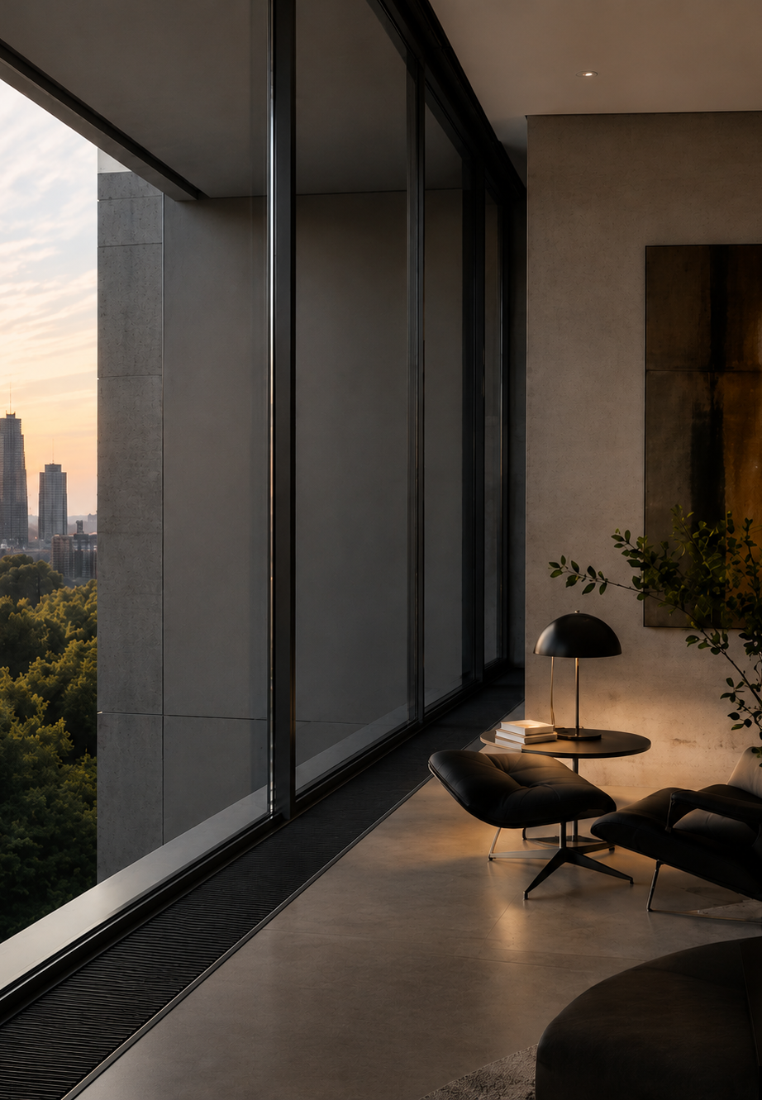



THE CULTURE OF HEAT
www.konveka.com
sales@konveka.lt
+370 677 06303

