Slide 1
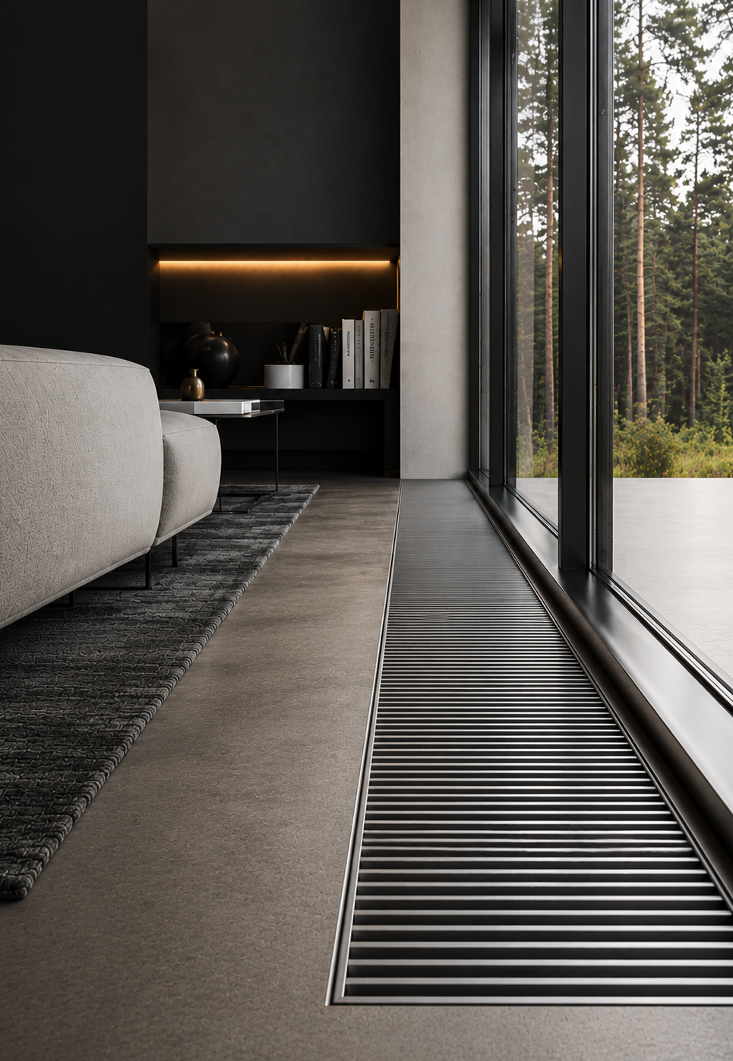




FC
TRENCH HEATERS
QUIET COMFORT
FOR MODERN ARCHITECTURE
HEATING
NATURAL CONVECTION
ABSOLUTE SILENCE
10-YEAR WARRANTY
DURABILITY. RELIABLE QUALITY.

Slide 2
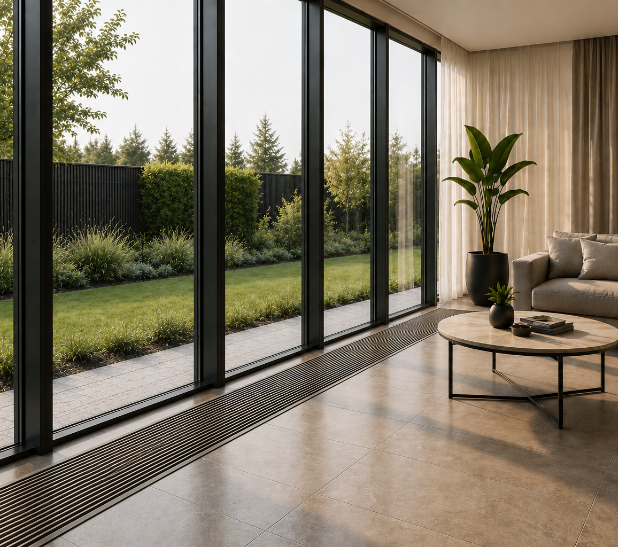
NATURAL HEAT FOR MODERN ARCHITECTURE
FC trench heaters work on the principle of natural convection - without fans and without noise.
Optimally designed heat exchangers create a gentle, evenly distributed heat curtain at the window, maintain a comfortable room temperature and keep the cold from entering.
FC is an elegant, durable and economical solution for modern architecture.
HEATING
NATURAL CONVECTION
NOISELESS
Natural convection
principle
Gentle, even heat throughout the whole room volume
Works without fans - no mechanical noise
02 | TRENCH HEATERS FC

Slide 3
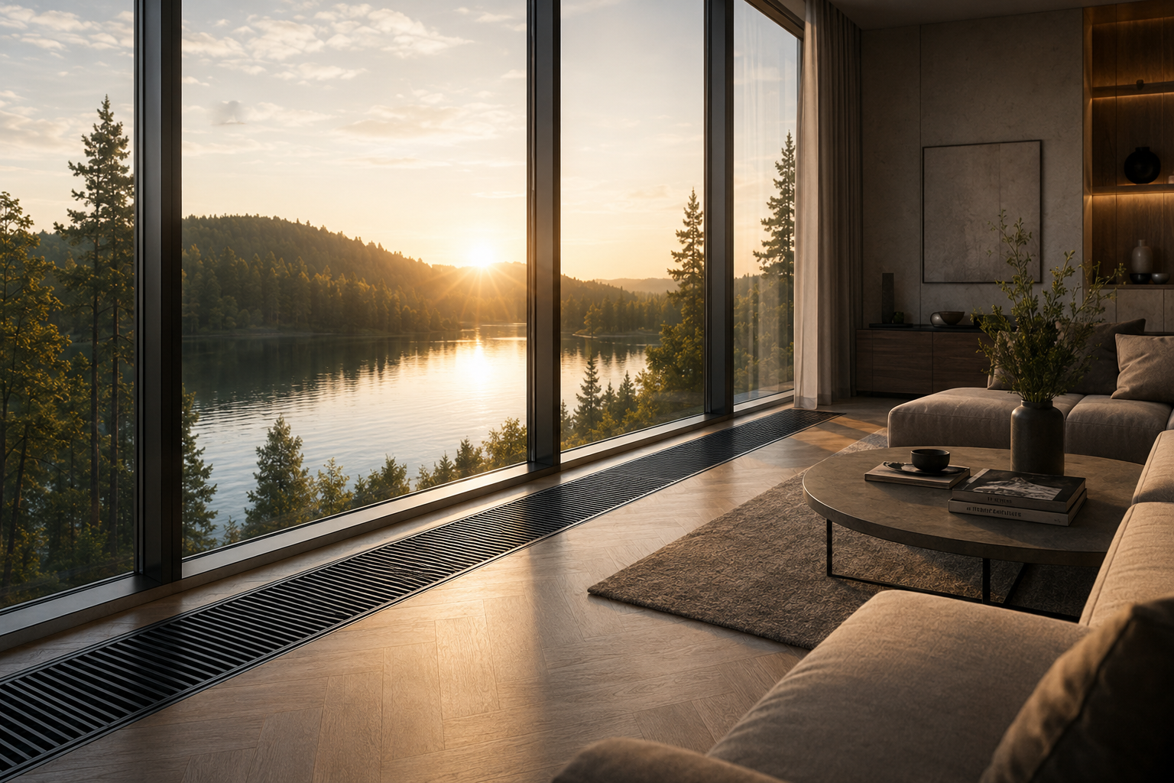

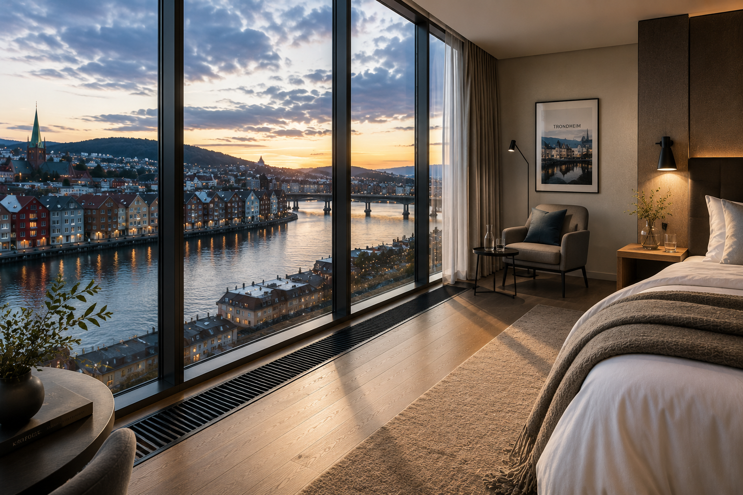

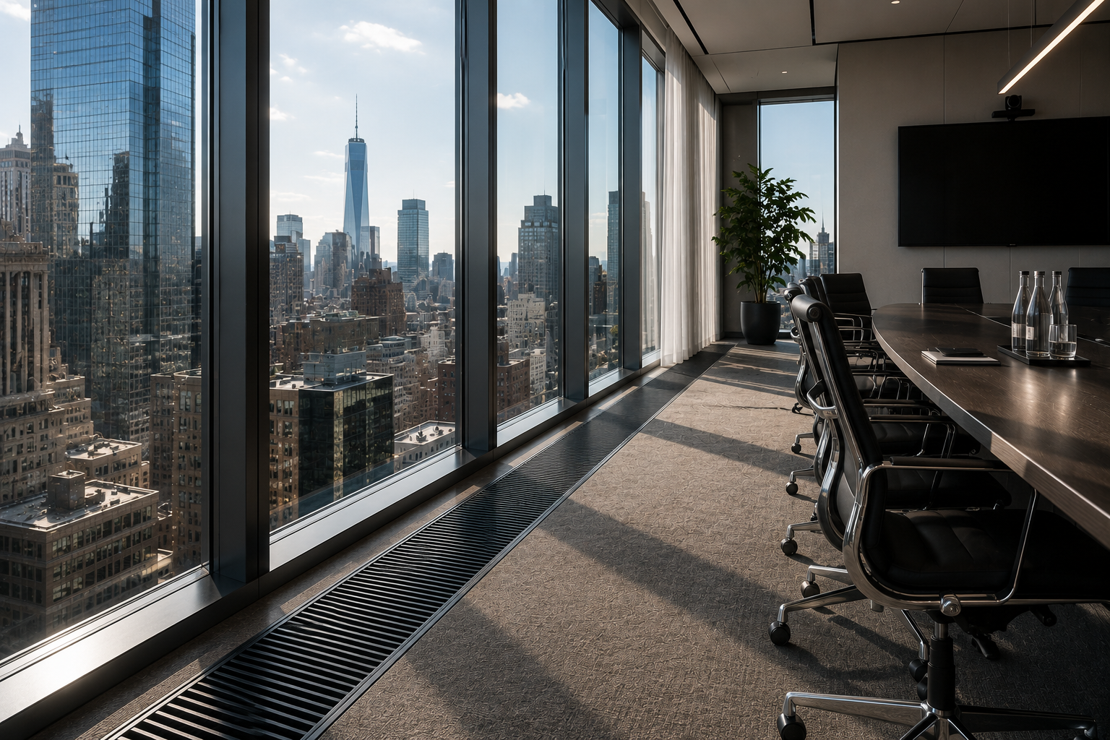

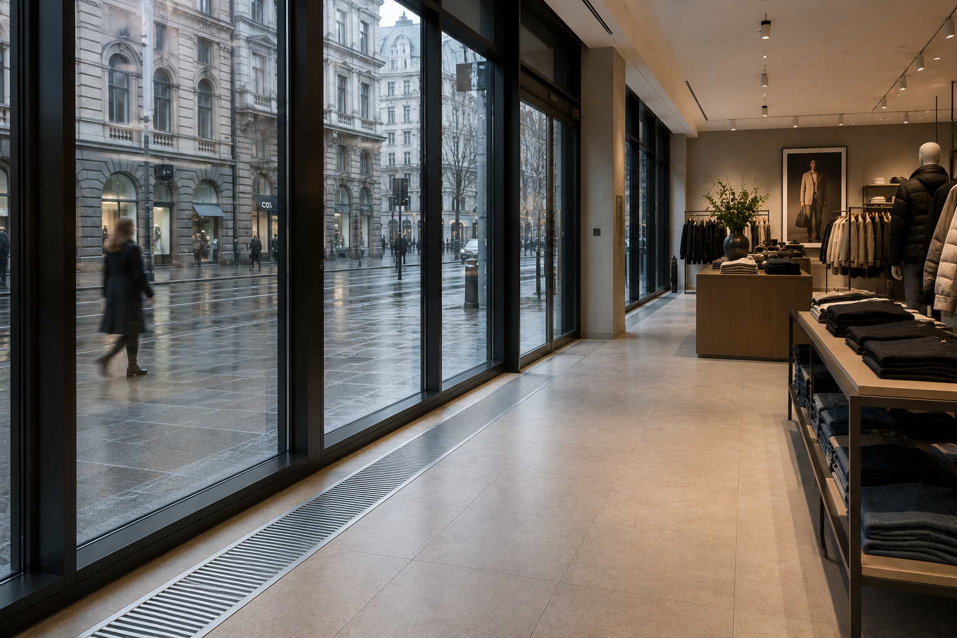

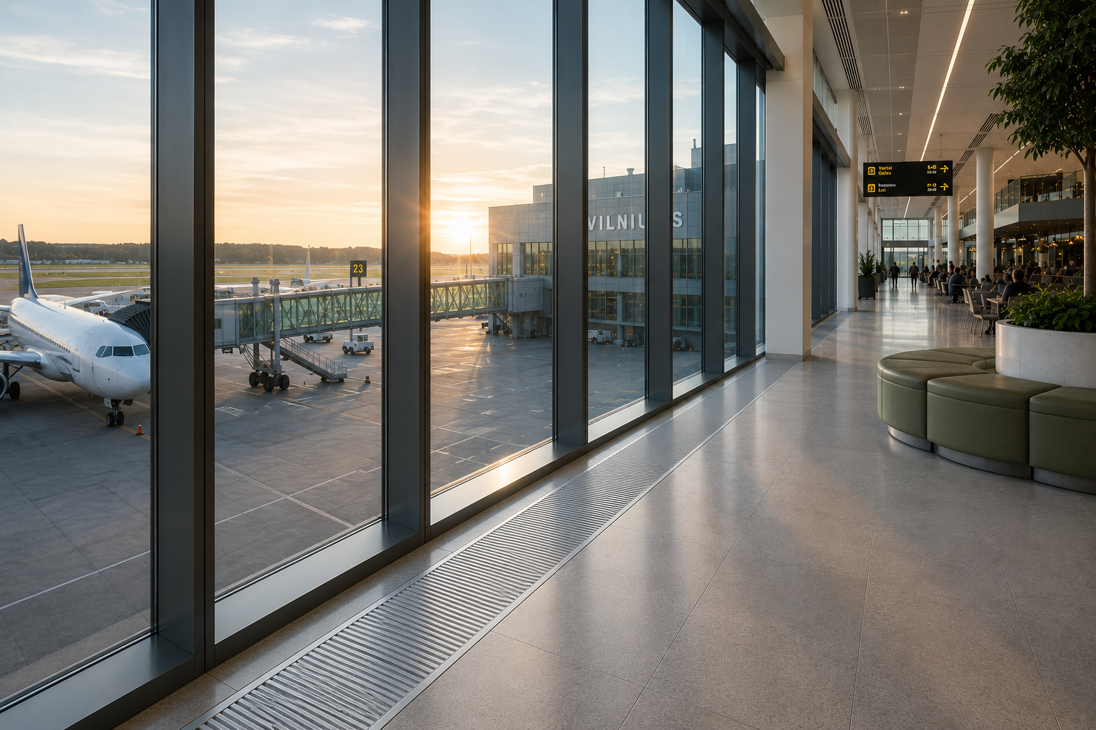

WHERE DOES FC FIT?
CREATED FOR CLEAN LINES
AND A COMFORTABLE ENVIRONMENT
Residential houses
Villas, apartments, private residences
Hotels
Lobbies, rooms, relaxation areas
Offices
Conference halls, open-plan spaces
Retail and service spaces
Shops, showrooms, galleries
Public spaces
Museums, libraries,
schools
TRENCH HEATERS FC | 03

Slide 4
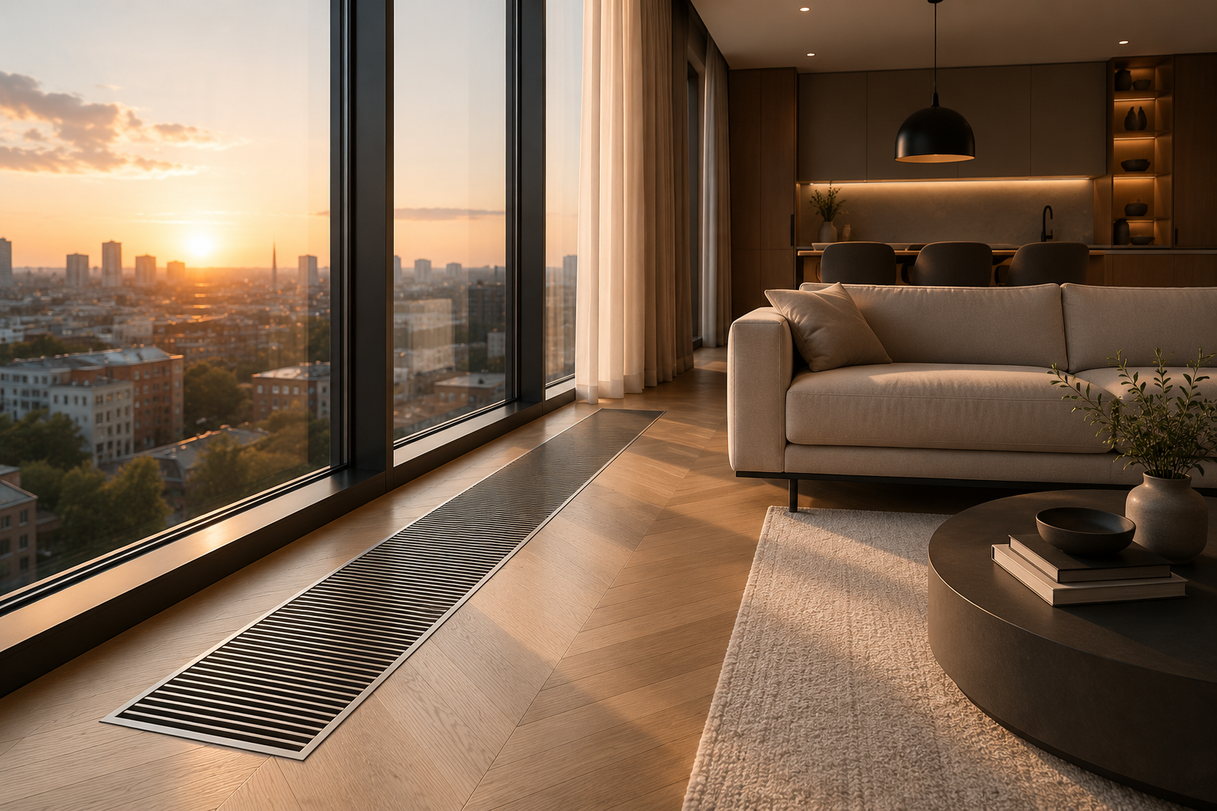







TECHNICAL DATA
Reliable operation, high efficiency and durable construction - for comfort every day
Maximum working pressure
25 bar
Maximum working temperature
120 °C
Factory test pressure
30 bar
Heat exchanger
strength limit
110 bar
Casing material
Stainless steel
Heat exchanger tubes
Copper
Heat exchanger fins
Aluminium
Warranty
10 years
LOW-TEMPERATURE
SYSTEMS
HIGH EFFICIENCY
LOW OPERATING COSTS
RELIABLE AND DURABLE CONSTRUCTION
Compatible with heat pumps and modern heating solutions
High heat transfer efficiency ensures efficient operation
Low thermal inertia ensures high efficiency of the units
Corrosion resistance and high quality standards for long-term use
04 | TRENCH HEATERS FC

Slide 5
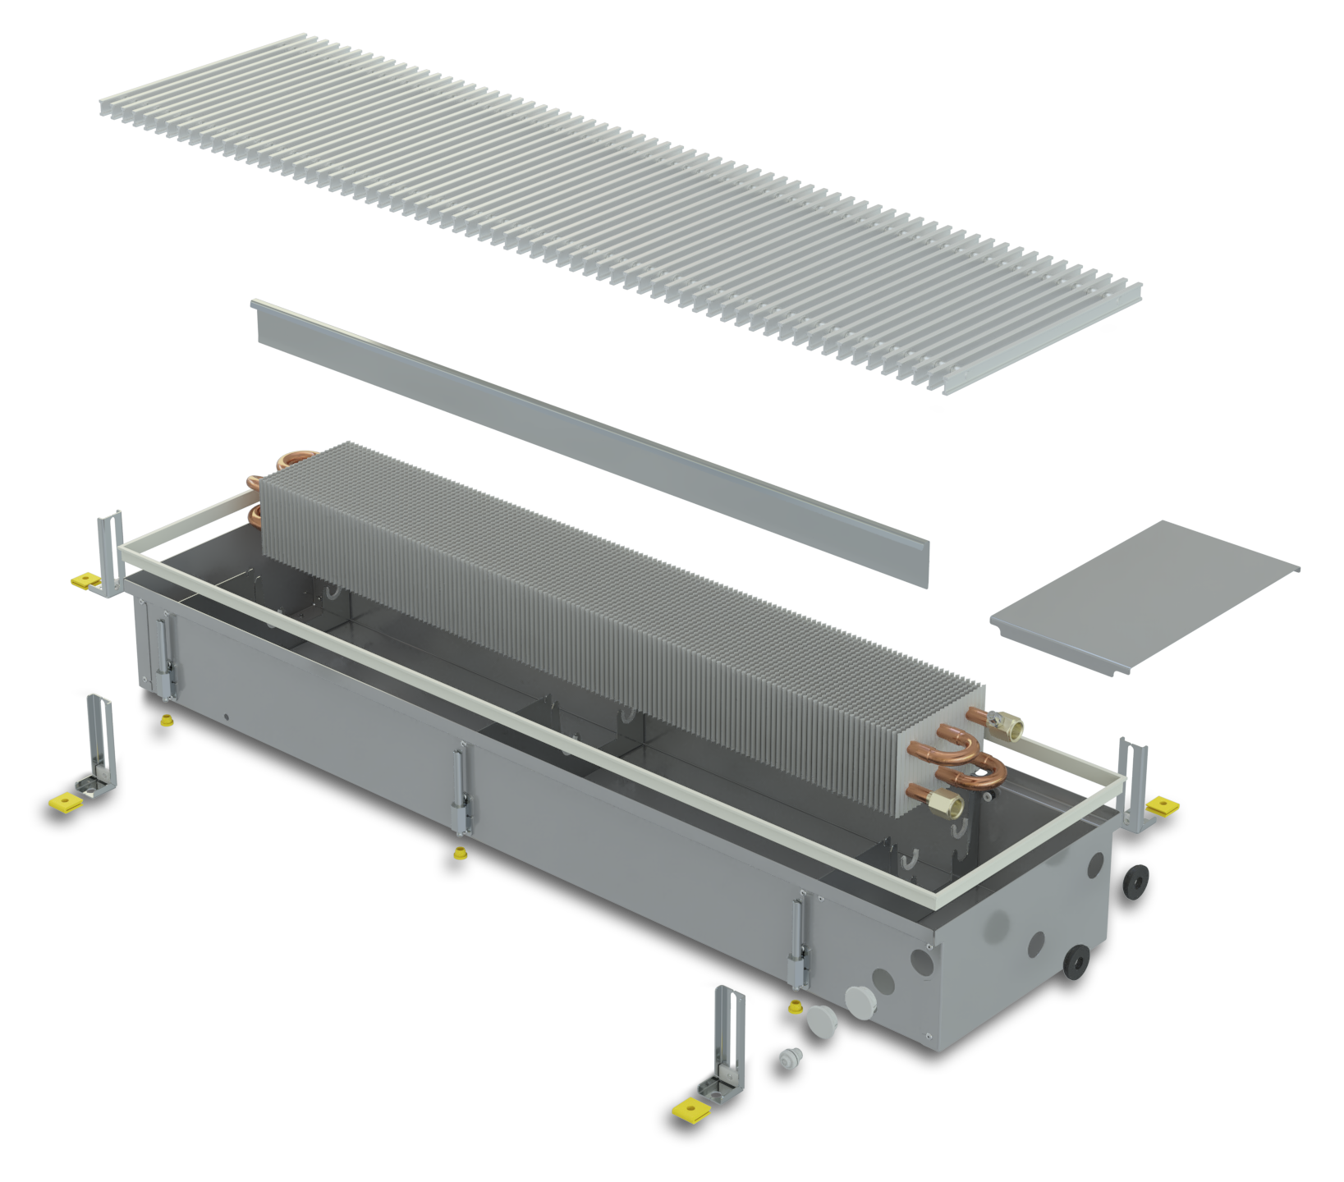


CONSTRUCTION AND MATERIALS
1
Stainless-steel casing
9
2
Casing stiffening elements
3
Copper-aluminium heat exchanger
4
4
Air deflection element
3
5
5
Hydraulic connections cover
6
Decorative anodised aluminium frame
2
Support screws with height adjustment
7
6
8
Floor-fixing brackets
7
1
9
Protective-decorative grilles
10
8
10
Pipe and cable seals
STAINLESS-STEEL CASINGS
DOUBLE-SIDED
REINFORCED-PROFILE
GRILLES
CASING STIFFENING ELEMENTS
High-quality stainless steel ensures durability and corrosion resistance
Anodised aluminium grilles provide greater strength, aesthetics and safe use
Additional stiffening elements increase the stability of the casing and its resistance to deformation
HEIGHT-ADJUSTABLE FEET
ACOUSTICALLY INSULATED FLOOR-FIXING PARTS
Precise height adjustment allows easy adaptation to various installation conditions
Special insulated parts reduce vibration and noise transmitted to the floor structure
TRENCH HEATERS FC | 05

Slide 6
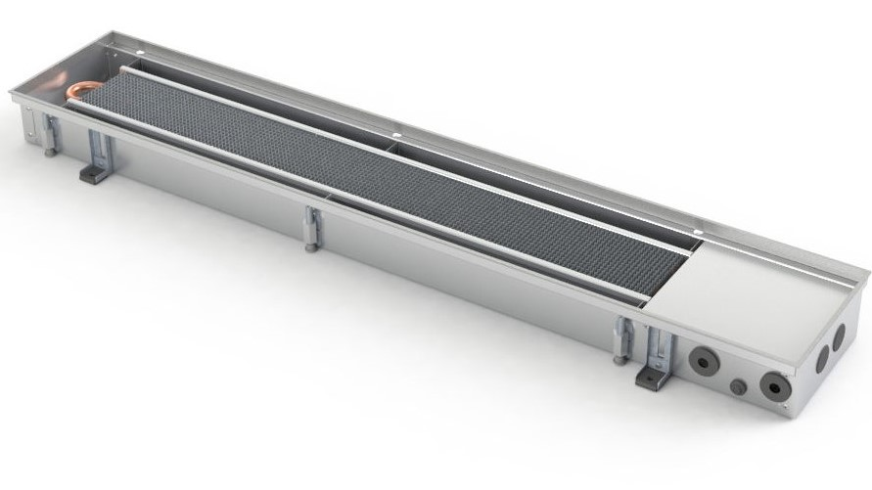
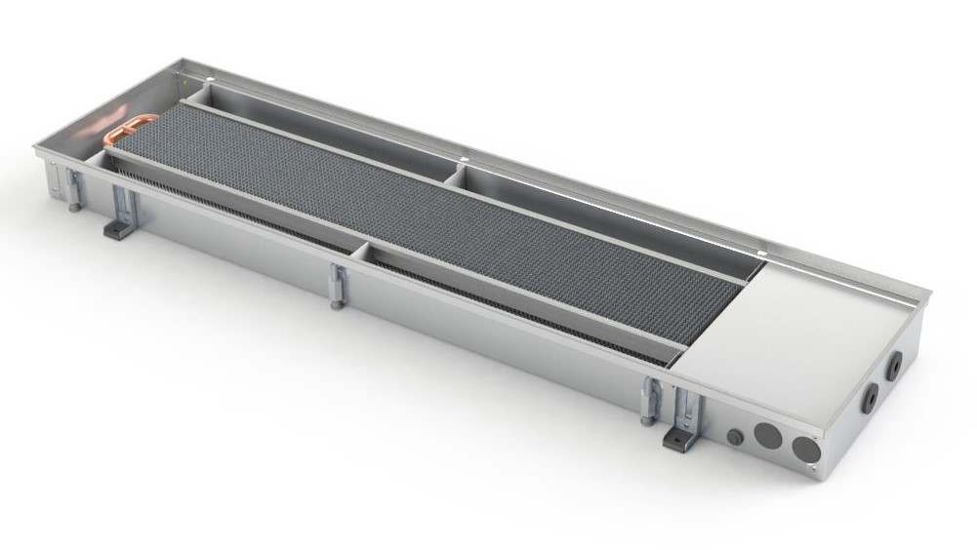
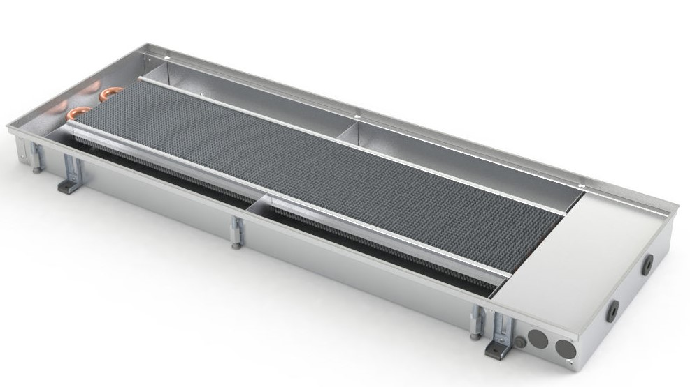
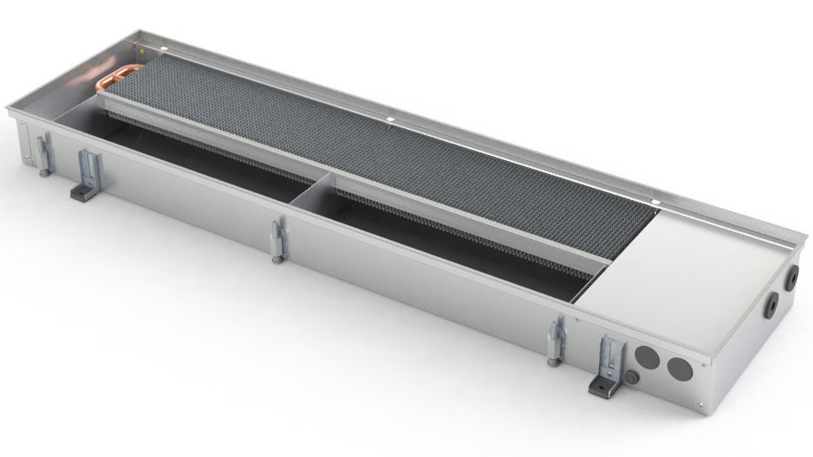
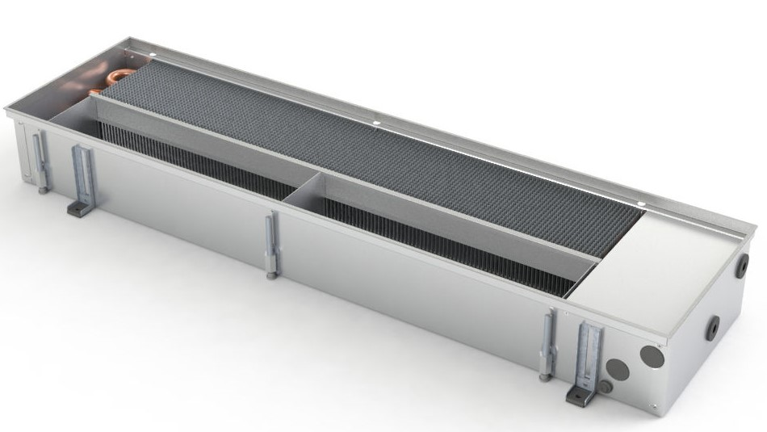


MODELS, DIMENSIONS AND OUTPUTS
WIDTH
22 cm
32 cm
42 cm
Compact
Versatile
Powerful
HEIGHT
9 cm
11 cm
15 cm
Compact
Versatile
Powerful
WIDTH:
HEIGHT:
LENGTH:
22 / 32 / 42 cm
9 / 11 / 15 cm
from 80 to 300 cm
THERMAL OUTPUT (W) AT 75/65/20°C EN16430
Width, cm | Height, cm | Length, cm
 |  | 80 | 90 | 100 | 110 | 120 | 130 | 140 | 150 | 160 | 170 | 180 | 190 | 200 | 210 | 220 | 230 | 240 | 250 | 260 | 270 | 280 | 290 | 300
22 | 9 | 179 | 211 | 242 | 274 | 305 | 336 | 368 | 399 | 430 | 462 | 493 | 524 | 556 | 587 | 619 | 650 | 681 | 713 | 744 | 775 | 807 | 838 | 870
 | 15 | 256 | 301 | 347 | 392 | 437 | 482 | 528 | 573 | 618 | 663 | 709 | 754 | 799 | 844 | 890 | 935 | 980 | 1025 | 1071 | 1116 | 1161 | 1206 | 1252
32 | 9 | 243 | 289 | 335 | 381 | 427 | 473 | 519 | 565 | 611 | 657 | 703 | 749 | 795 | 841 | 887 | 933 | 979 | 1025 | 1071 | 1118 | 1164 | 1210 | 1256
 | 11 | 252 | 300 | 347 | 394 | 442 | 489 | 537 | 584 | 632 | 679 | 727 | 774 | 822 | 869 | 917 | 964 | 1012 | 1059 | 1106 | 1154 | 1201 | 1249 | 1296
 | 15 | 383 | 451 | 518 | 586 | 653 | 721 | 788 | 855 | 923 | 990 | 1058 | 1125 | 1193 | 1260 | 1328 | 1395 | 1463 | 1530 | 1598 | 1665 | 1733 | 1800 | 1868
42 | 9 | 292 | 343 | 393 | 444 | 495 | 546 | 596 | 647 | 698 | 749 | 800 | 850 | 901 | 952 | 1003 | 1053 | 1104 | 1155 | 1206 | 1256 | 1307 | 1358 | 1409
 | 11 | 353 | 415 | 477 | 539 | 601 | 663 | 725 | 787 | 849 | 911 | 973 | 1035 | 1097 | 1159 | 1221 | 1283 | 1345 | 1407 | 1469 | 1531 | 1593 | 1655 | 1717
 | 15 | 497 | 585 | 672 | 760 | 848 | 935 | 1023 | 1110 | 1198 | 1285 | 1373 | 1460 | 1548 | 1636 | 1723 | 1811 | 1898 | 1986 | 2073 | 2161 | 2248 | 2336 | 2424
You can find thermal outputs at non-standard temperatures at konveka.com
https://konveka.com/product/trench-heaters/grindiniai-konvektoriai-be-ventiliatoriu-fc/
06 | TRENCH HEATERS FC

Slide 7
MODELS, DIMENSIONS AND OUTPUTS
THERMAL OUTPUT (W) AT 65/55/20°C EN16430
Width, cm | Height, cm | Length, cm
 |  | 80 | 90 | 100 | 110 | 120 | 130 | 140 | 150 | 160 | 170 | 180 | 190 | 200 | 210 | 220 | 230 | 240 | 250 | 260 | 270 | 280 | 290 | 300
22 | 9 | 134 | 158 | 181 | 204 | 228 | 251 | 275 | 298 | 322 | 345 | 369 | 392 | 415 | 439 | 462 | 486 | 509 | 533 | 556 | 579 | 603 | 626 | 650
 | 15 | 183 | 215 | 247 | 280 | 312 | 344 | 376 | 409 | 441 | 473 | 505 | 538 | 570 | 602 | 635 | 667 | 699 | 731 | 764 | 796 | 828 | 860 | 893
32 | 9 | 180 | 214 | 248 | 283 | 317 | 351 | 385 | 419 | 453 | 487 | 522 | 556 | 590 | 624 | 658 | 692 | 727 | 761 | 795 | 829 | 863 | 897 | 932
 | 11 | 183 | 218 | 253 | 287 | 322 | 356 | 391 | 425 | 460 | 494 | 529 | 564 | 598 | 633 | 667 | 702 | 736 | 771 | 805 | 840 | 875 | 909 | 944
 | 15 | 278 | 327 | 376 | 425 | 474 | 523 | 572 | 621 | 670 | 719 | 768 | 817 | 866 | 915 | 964 | 1013 | 1062 | 1111 | 1160 | 1209 | 1258 | 1307 | 1356
42 | 9 | 215 | 252 | 290 | 327 | 364 | 402 | 439 | 476 | 514 | 551 | 589 | 626 | 663 | 701 | 738 | 775 | 813 | 850 | 888 | 925 | 962 | 1000 | 1037
 | 11 | 258 | 303 | 348 | 393 | 438 | 483 | 529 | 574 | 619 | 664 | 709 | 754 | 800 | 845 | 890 | 935 | 980 | 1026 | 1071 | 1116 | 1161 | 1206 | 1251
 | 15 | 357 | 420 | 483 | 546 | 609 | 672 | 734 | 797 | 860 | 923 | 986 | 1049 | 1112 | 1175 | 1238 | 1300 | 1363 | 1426 | 1489 | 1552 | 1615 | 1678 | 1741
THERMAL OUTPUT (W) AT 55/45/20°C EN16430
Width, cm | Height, cm | Length, cm
 |  | 80 | 90 | 100 | 110 | 120 | 130 | 140 | 150 | 160 | 170 | 180 | 190 | 200 | 210 | 220 | 230 | 240 | 250 | 260 | 270 | 280 | 290 | 300
22 | 9 | 92 | 108 | 124 | 140 | 157 | 173 | 189 | 205 | 221 | 237 | 253 | 269 | 285 | 301 | 318 | 334 | 350 | 366 | 382 | 398 | 414 | 430 | 446
 | 15 | 118 | 139 | 160 | 181 | 202 | 223 | 243 | 264 | 285 | 306 | 327 | 348 | 369 | 390 | 411 | 431 | 452 | 473 | 494 | 515 | 536 | 557 | 578
32 | 9 | 123 | 146 | 169 | 192 | 215 | 239 | 262 | 285 | 308 | 332 | 355 | 378 | 401 | 425 | 448 | 471 | 494 | 518 | 541 | 564 | 587 | 611 | 634
 | 11 | 122 | 145 | 168 | 191 | 214 | 237 | 260 | 283 | 305 | 328 | 351 | 374 | 397 | 420 | 443 | 466 | 489 | 512 | 535 | 558 | 581 | 604 | 627
 | 15 | 184 | 217 | 249 | 281 | 314 | 346 | 379 | 411 | 444 | 476 | 508 | 541 | 573 | 606 | 638 | 670 | 703 | 735 | 768 | 800 | 833 | 865 | 897
42 | 9 | 145 | 170 | 195 | 220 | 246 | 271 | 296 | 321 | 346 | 371 | 397 | 422 | 447 | 472 | 497 | 523 | 548 | 573 | 598 | 623 | 648 | 674 | 699
 | 11 | 171 | 201 | 231 | 261 | 291 | 322 | 352 | 382 | 412 | 442 | 472 | 502 | 532 | 562 | 592 | 622 | 652 | 682 | 712 | 742 | 772 | 802 | 832
 | 15 | 233 | 274 | 315 | 356 | 397 | 438 | 479 | 520 | 561 | 602 | 644 | 685 | 726 | 767 | 808 | 849 | 890 | 931 | 972 | 1013 | 1054 | 1095 | 1136
WATER PRESSURE LOSS
Width, cm | Height, cm | Max. water flow, l/h | Water pressure loss calculation formula, Pa
22 | 9 | 133 | (L - 0,290) x (0,0074 x q² - 0,0501 x q + 0,0796)
 | 15 | 197 | (L - 0,245) x (0,0078 x q² + 1,3090 x q - 20,44)
32 | 9 | 176 | (L - 0,290) x (0,0022 x q² + 0,3040 x q + 4,12)
 | 11 | 207 | (L - 0,290) x (0,0022 x q² + 0,3040 x q + 4,12)
 | 15 | 317 | (L - 0,245) x (0,0111 x q² + 2,2429 x q - 58,22)
42 | 9 | 245 | (L - 0,245) x (0,0078 x q² + 1,3090 x q - 20,44)
 | 11 | 293 | (L - 0,245) x (0,0078 x q² + 1,3090 x q - 20,44)
 | 15 | 398 | (L - 0,245) x (0,0157 x q² + 2,6179 x q - 40,88)
You can find thermal outputs at non-standard temperatures at konveka.com
https://konveka.com/product/trench-heaters/grindiniai-konvektoriai-be-ventiliatoriu-fc/
TRENCH HEATERS FC | 07

Slide 8
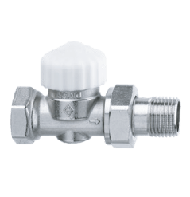

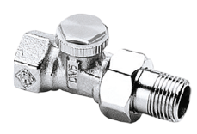
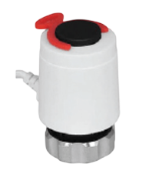
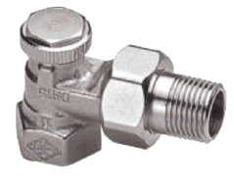
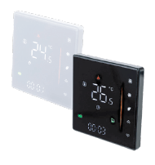



ACCESSORIES
FC trench heaters are offered with a full range of accessories and control equipment, ensuring reliable operation, energy efficiency and easy integration into building management systems
01
THERMOSTATIC VALVE
TVSP15
02
LOCKSHIELD VALVE (STRAIGHT)
LS15
Working temperature -10°C -120°C
Working temperature -10°C -120°C
Thread 1/2"
Thread 1/2"
Pressure class PN10
Pressure class PN10
Kvs
Kvs - 2,0
Kvs
Kvs - 2,0
03
LOCKSHIELD VALVE (ANGLE)
LA15
04
ACTUATOR
A230NC
Working temperature -10°C -120°C
Operating voltage
230 V AC
Thread 1/2"
El. power - 2.5 W
Pressure class PN10
Protection class - IP54
Kvs
Kvs - 2,0
Connection thread M30 x 1.5 mm
PC/ABS
Casing material PC/ABS
05
ROOM THERMOSTAT
TW230
Dimensions
88 x 88 x 37,5 mm
Weekly temperature
scheduling
Working temperature 5-35°C
Operating voltage – 230 V AC, current - 3A
El. power - 1.5 W
FULL SYSTEM
INTEGRATION
ENERGY EFFICIENCY
SIMPLE INSTALLATION
RELIABLE OPERATION
Compatible with the most popular control systems
Precise control ensures
lower operating costs.
Compact accessories and convenient installation
High-quality components for long, trouble-free operation
TRENCH HEATERS FC | 08

Slide 9
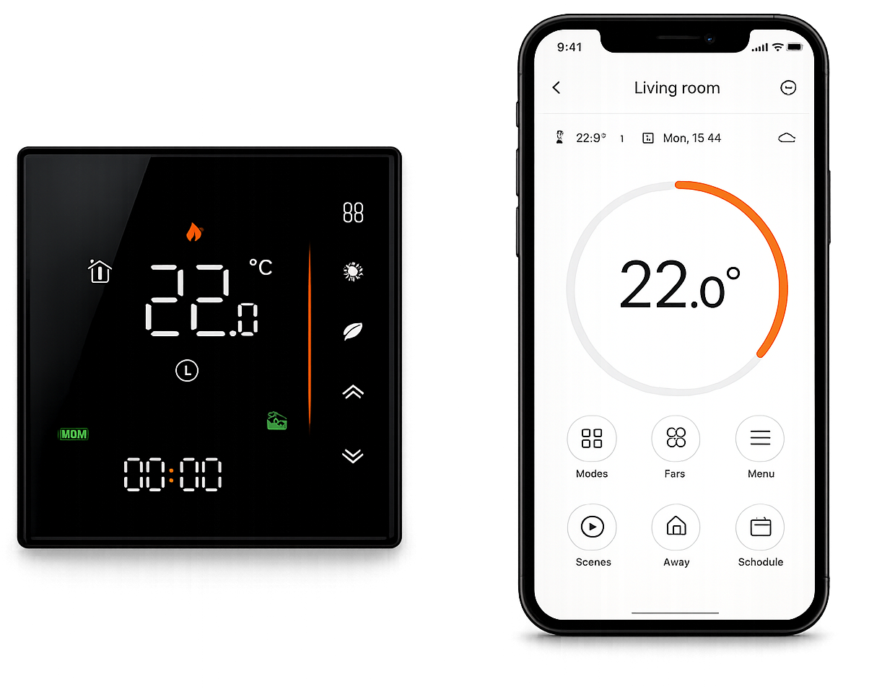













CONTROL AND
DIGITAL INTEGRATION
FC convectors are fully compatible with modern building management systems. Smart Wi-Fi thermostats TW230-16 allow precise control of the devices from anywhere in the world.
Room thermostat
TW230-16
CONTROL WITH TW230-16
CONTROL PRINCIPLE
OPERATING-TIME PROGRAMMING
SMART CONTROL
PRECISE COMFORT CONTROL
Depending on the heating demand, room thermostats control the actuators that regulate the flow of water into the heater
Operating-time programming allows energy consumption to be optimised
and reduce operating costs
Integrated into building management systems (BMS) using Modbus technology
Thanks to the integrated Wi-Fi module, TW230-16 thermostats can be controlled from anywhere in the world
BIM AND DIGITAL
DESIGN TOOLS
All Konveka products are available in BIM format (Revit) and in DWG drawings
All Konveka products are available and continuously updated on the MagiCAD and Sankom design platforms
Selection tables for all Konveka products are available at konveka.com
konveka.com
09 | TRENCH HEATERS FC

Slide 10
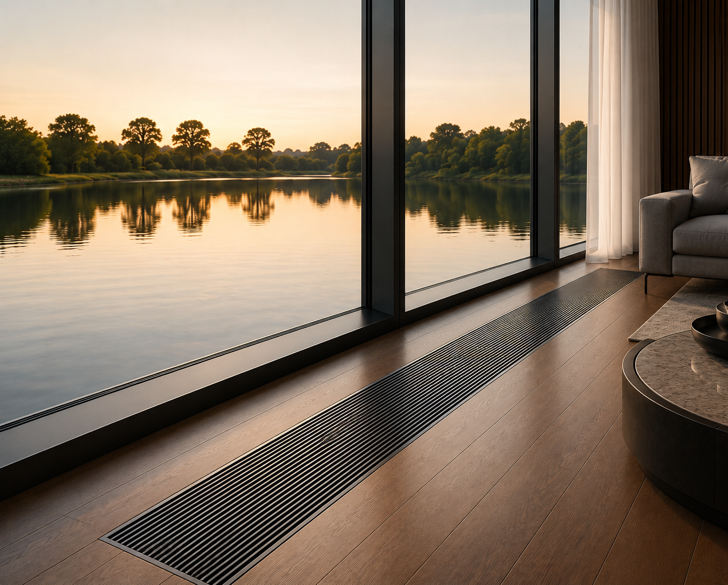
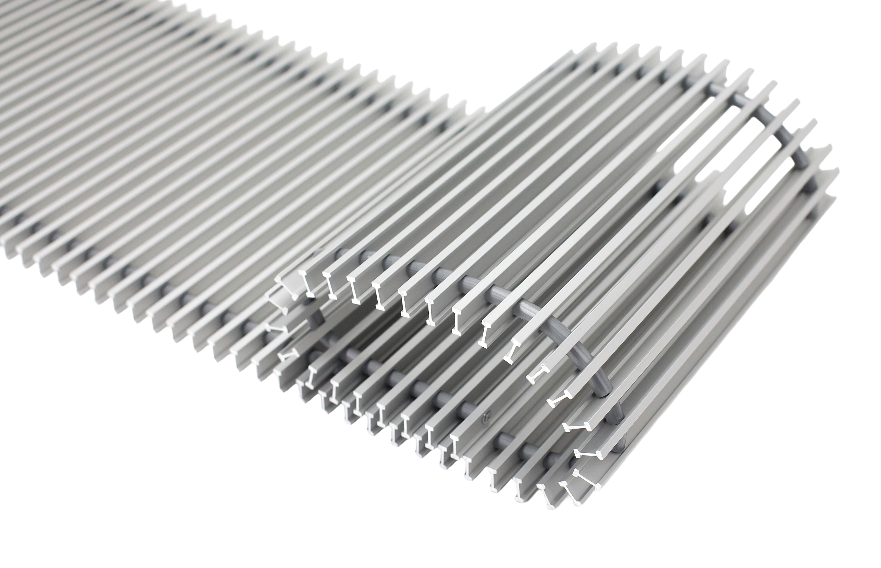
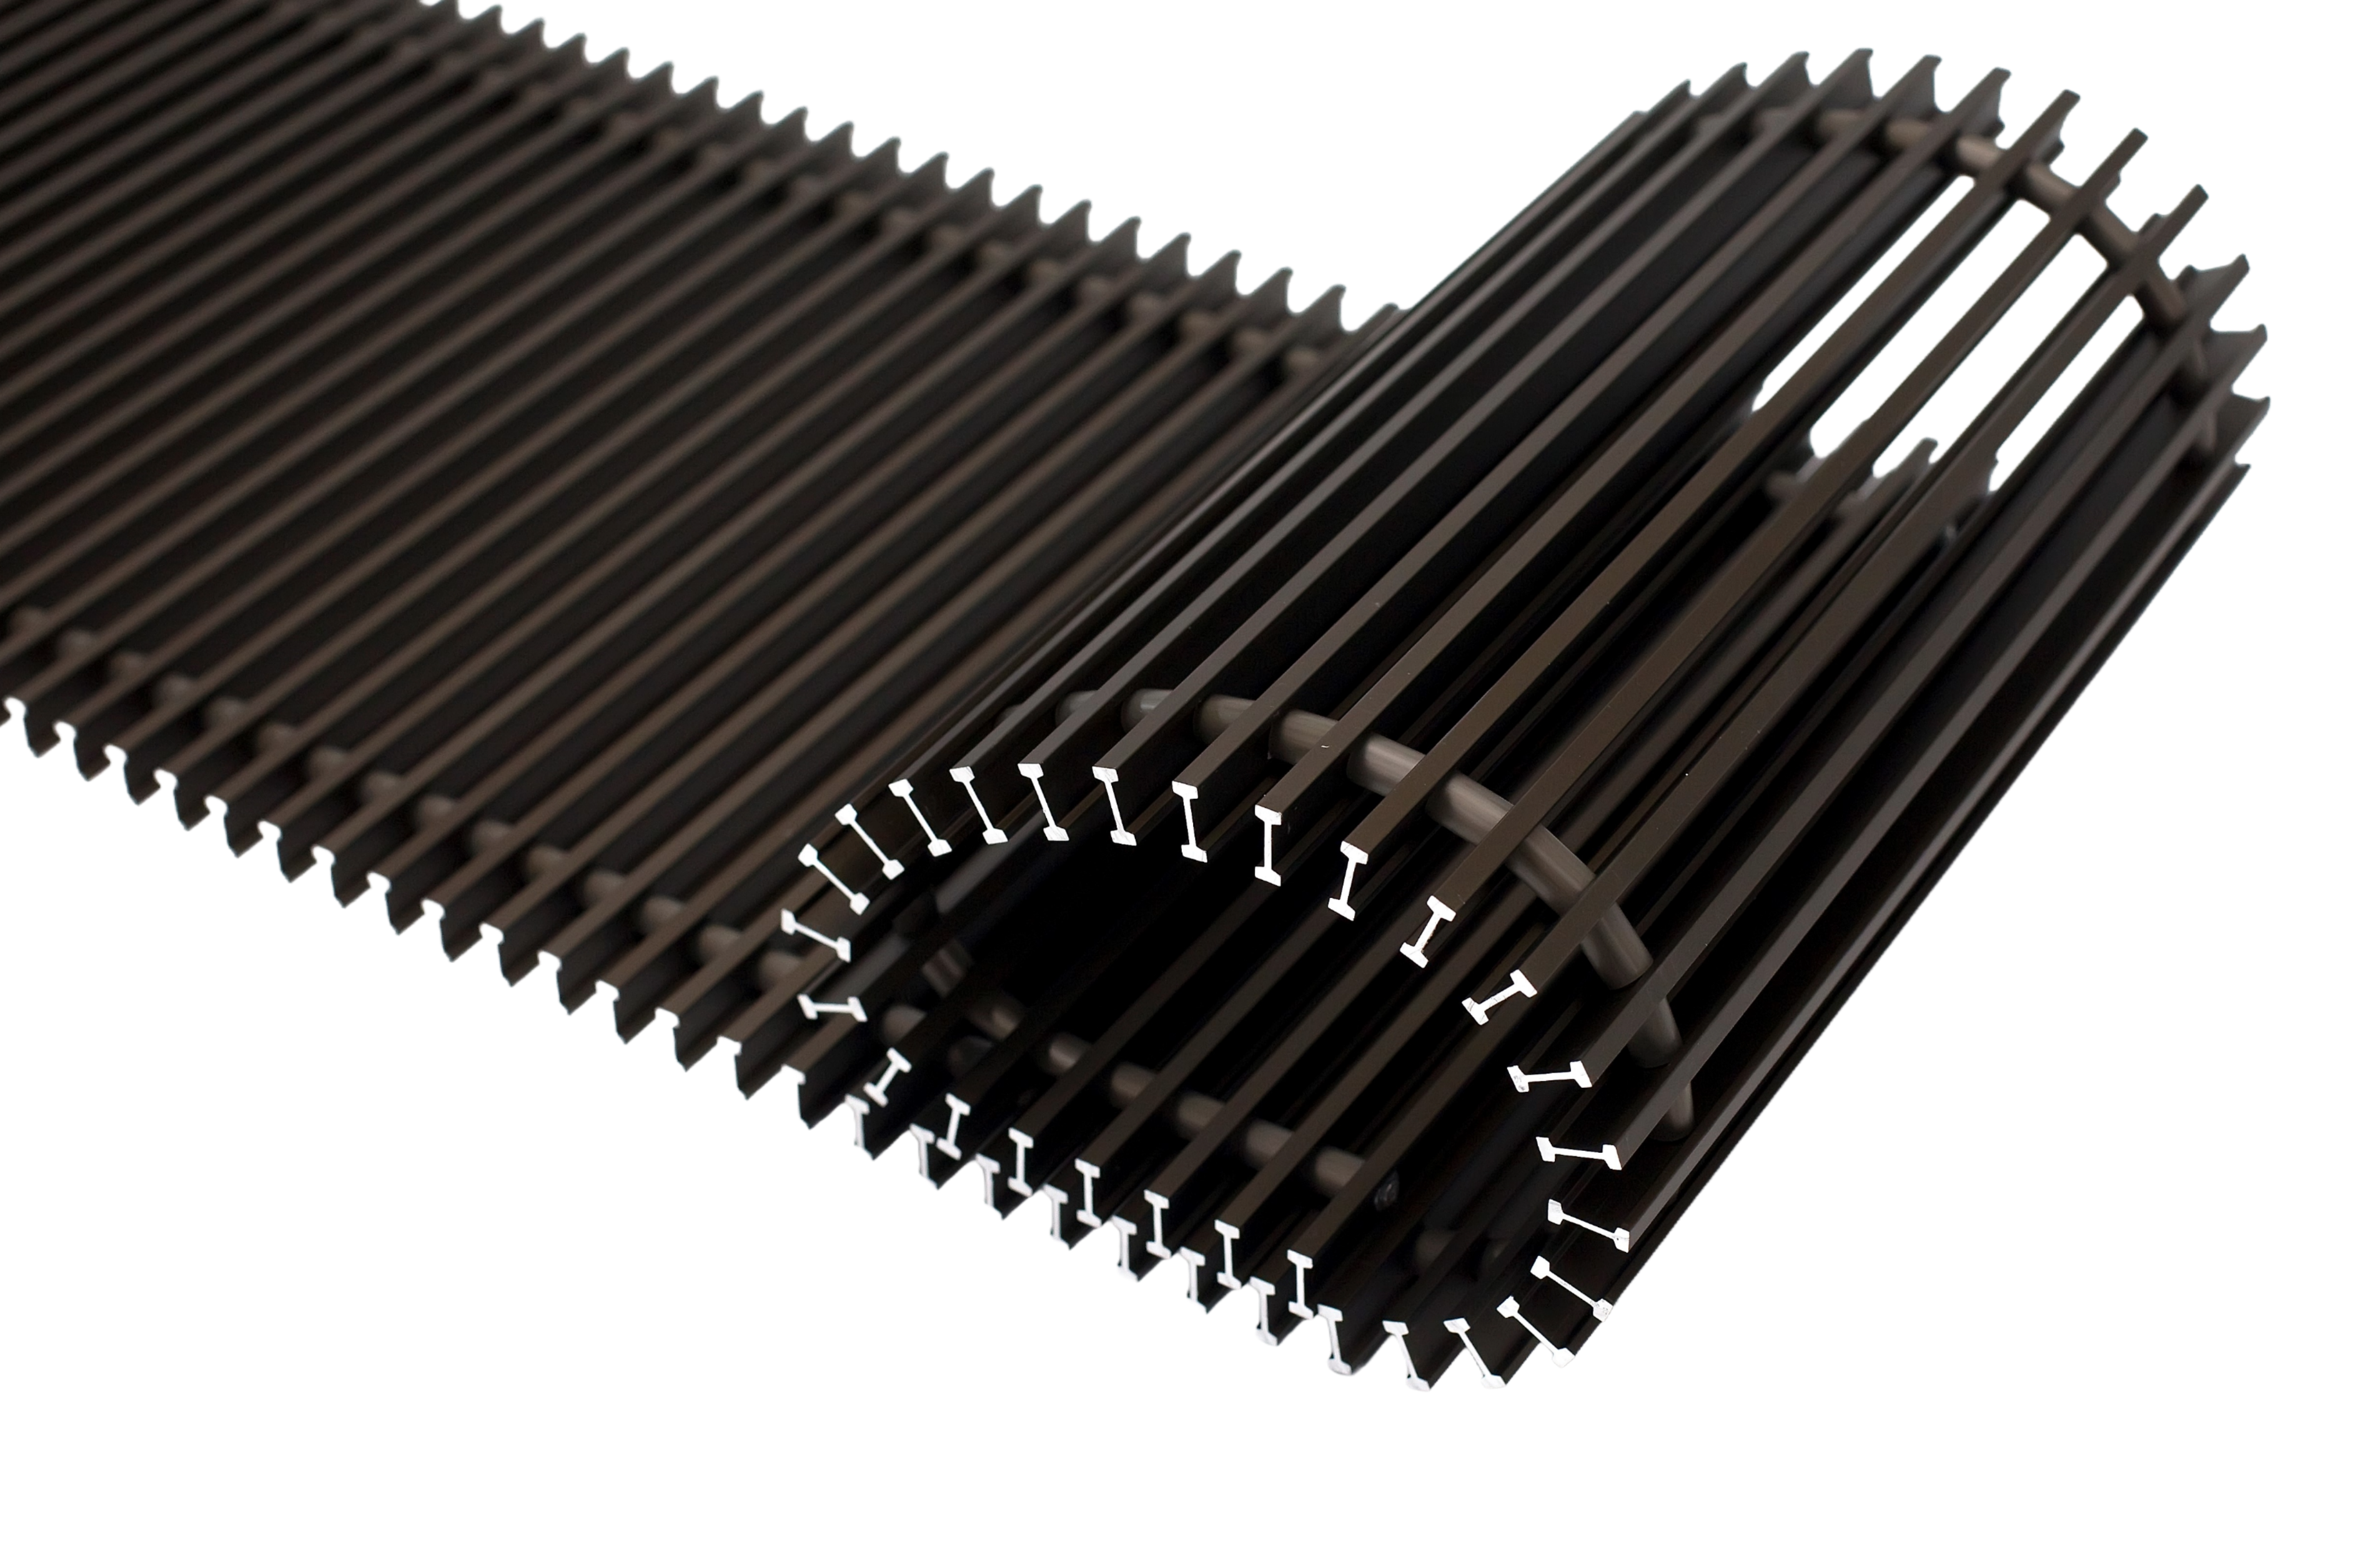
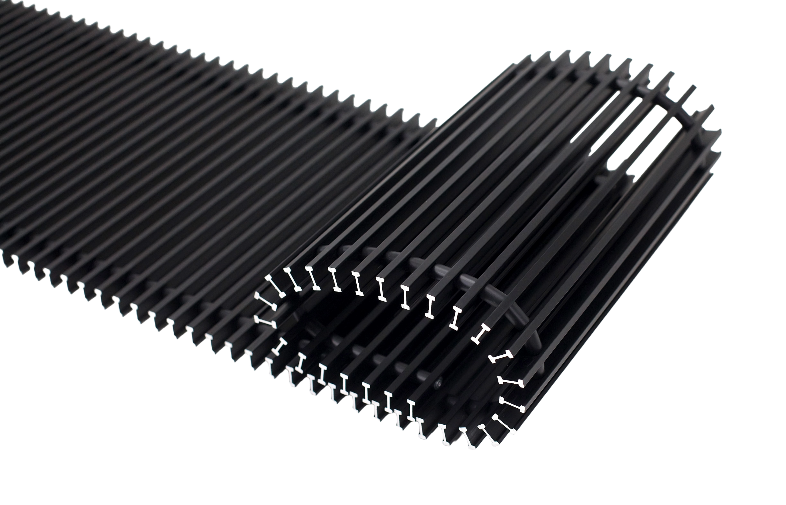
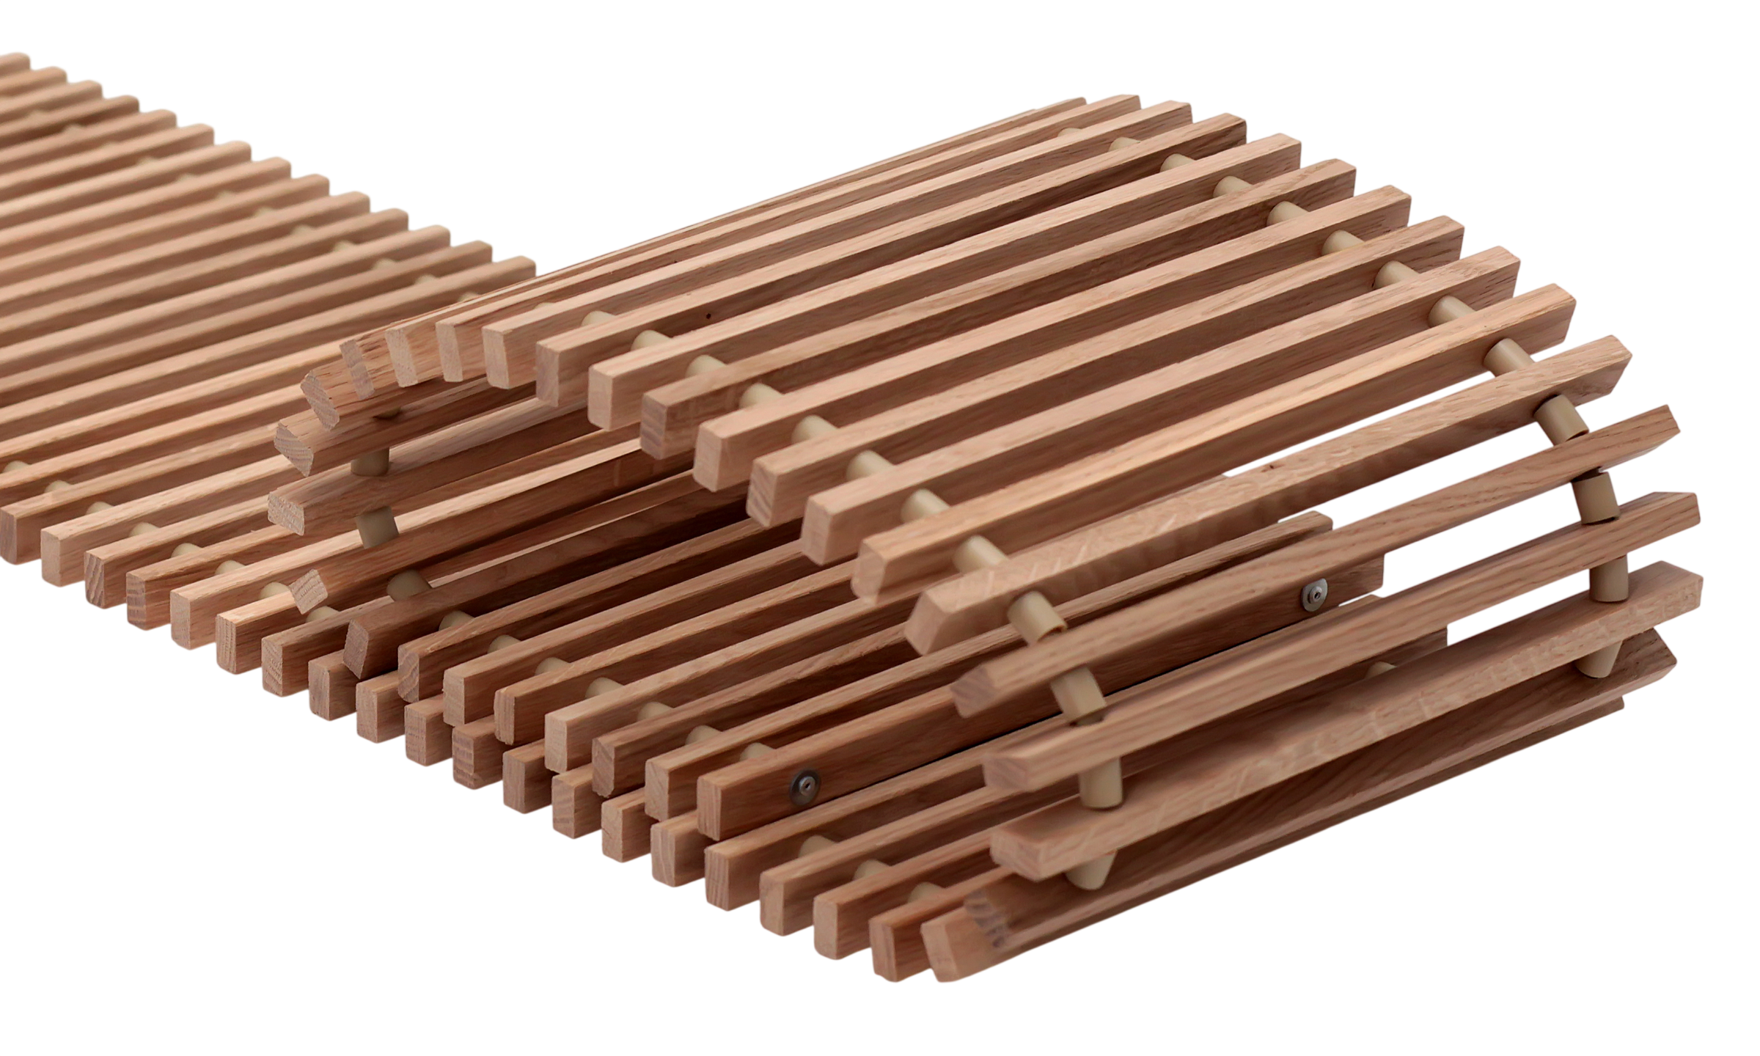



DECORATIVE GRILLES
THAT BECOME
PART OF THE INTERIOR
Elegant design.
The highest-quality materials.
Colours that create the character of a space
Choose the grilles that
best reflect your project
COLLECTION OF COLOURS AND MATERIALS
SILVER (ALS)
BROWN
(AL 10)
BLACK
(AL 50)
OAK
Natural aluminium
colour
For bright, modern interiors.
A warm and elegant dark-brown coating
For cosy classic interiors
A matte black colour giving a character of luxury and modernity
For luxurious and
modern interiors
Natural oak
solid-wood grille
For cosy and harmonious interiors
PREMIUM
QUALITY
STRENGTH
DURABILITY
EASY MAINTENANCE
Top-quality materials and coatings
Designed to withstand the weight of several adults
Materials and coatings resistant to corrosion and UV radiation
Easily removable - convenient to clean the inside of the heater
TRENCH HEATERS FC | 10

Slide 11
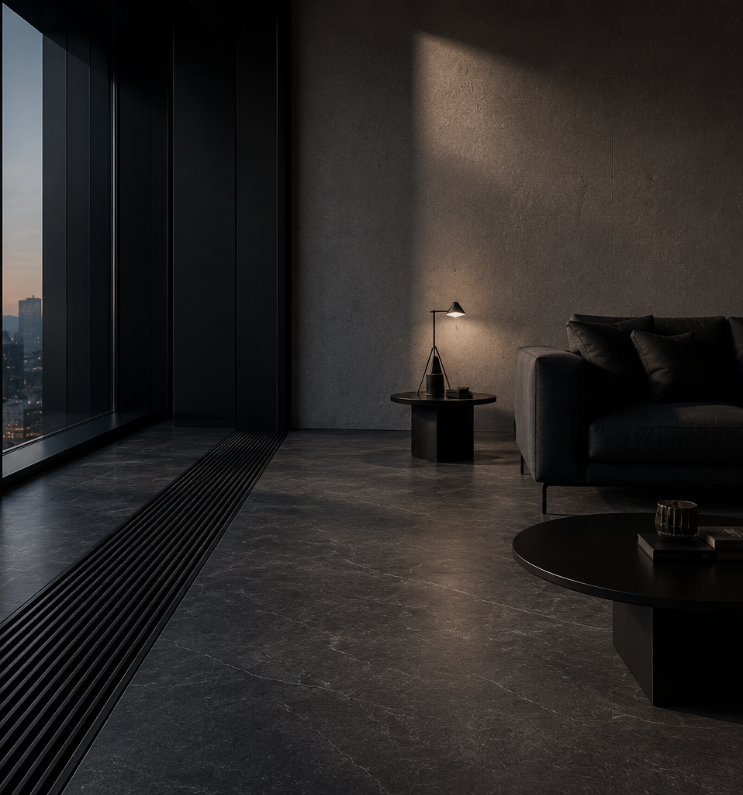
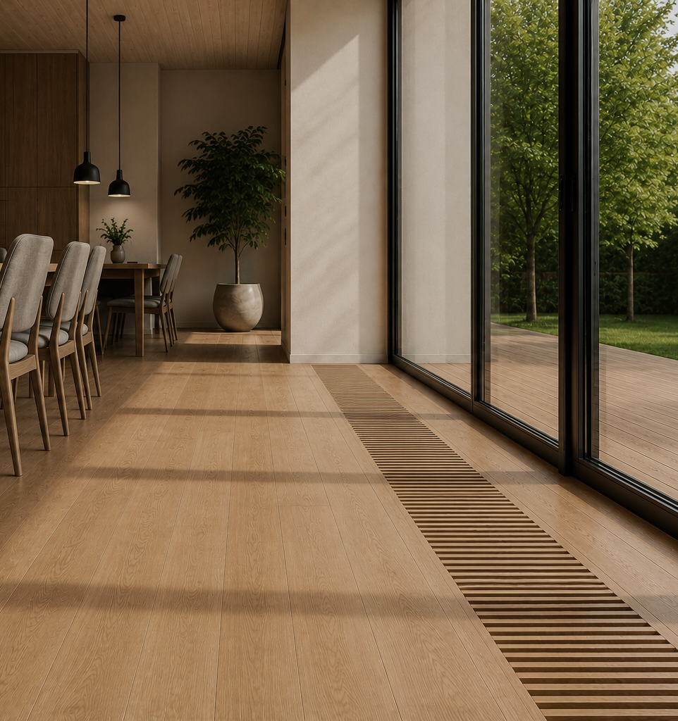
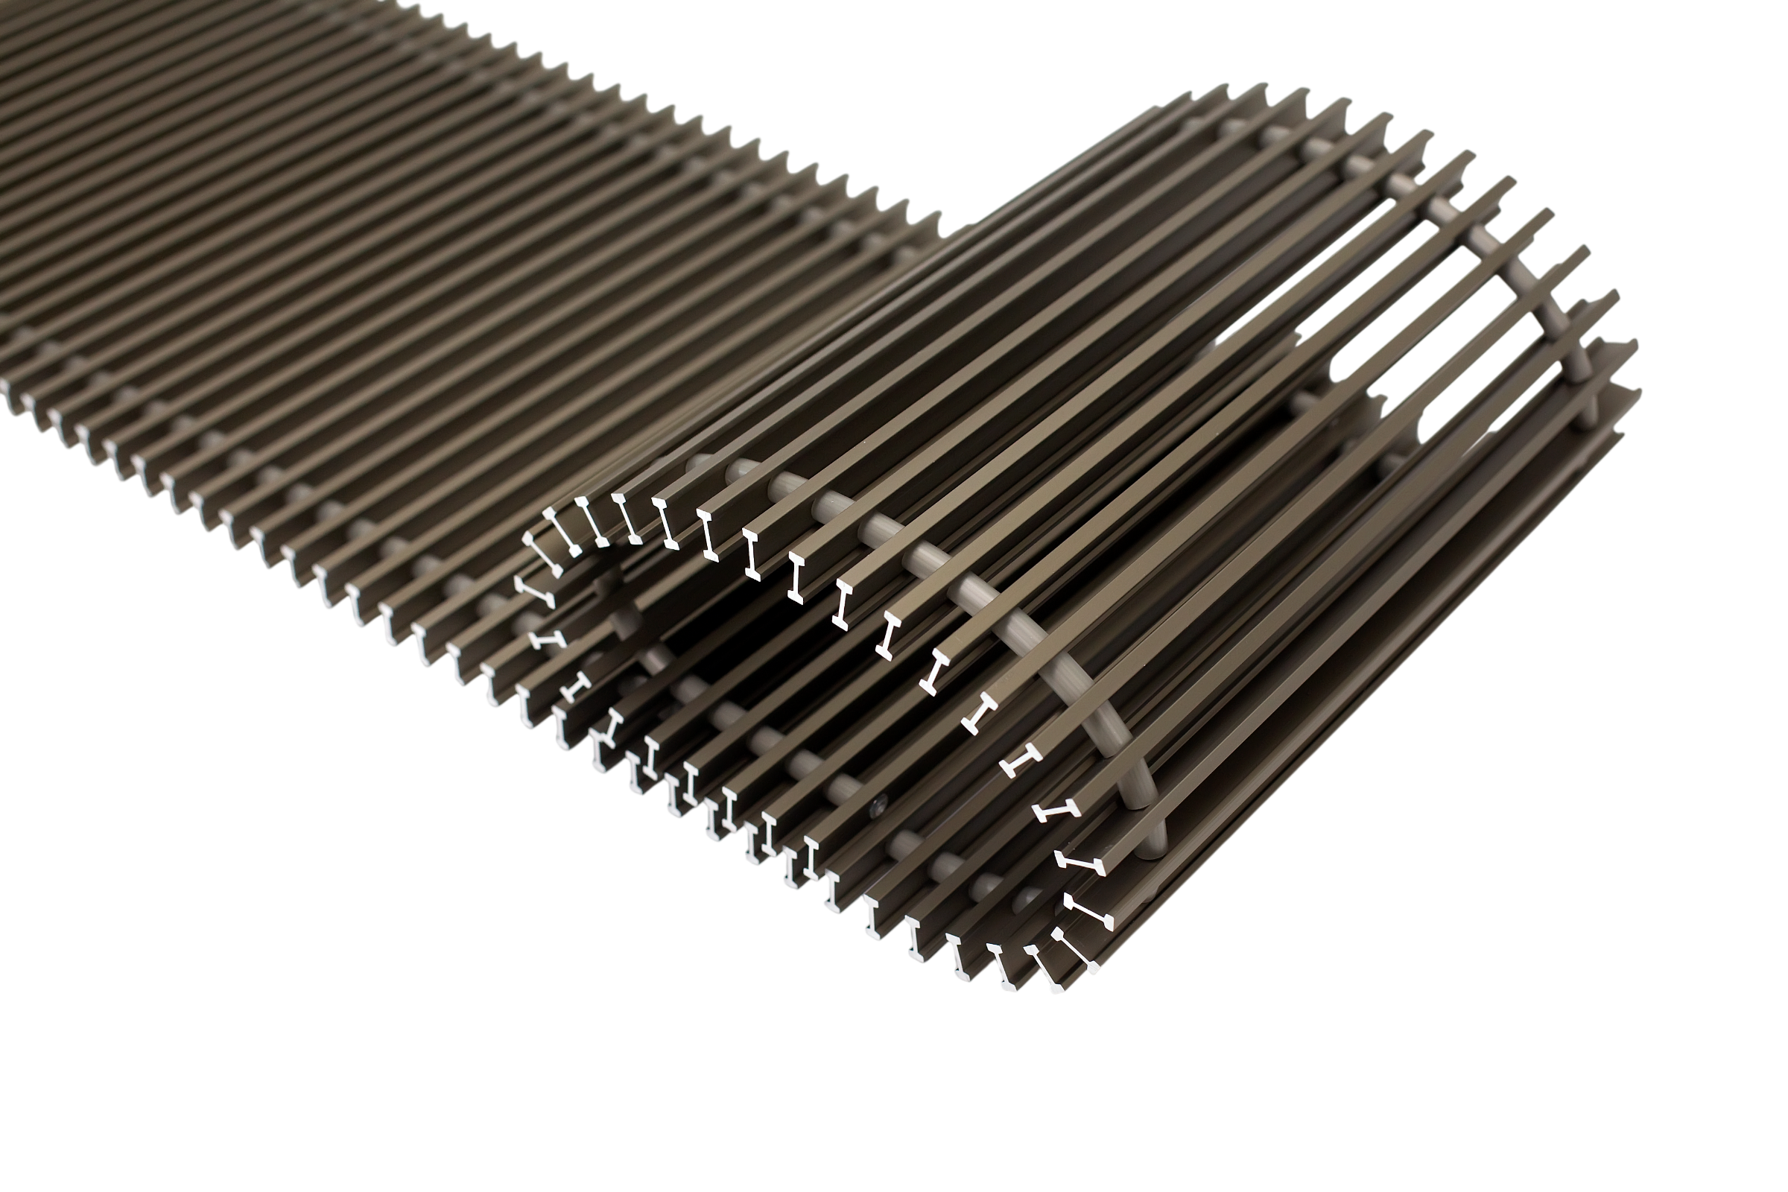
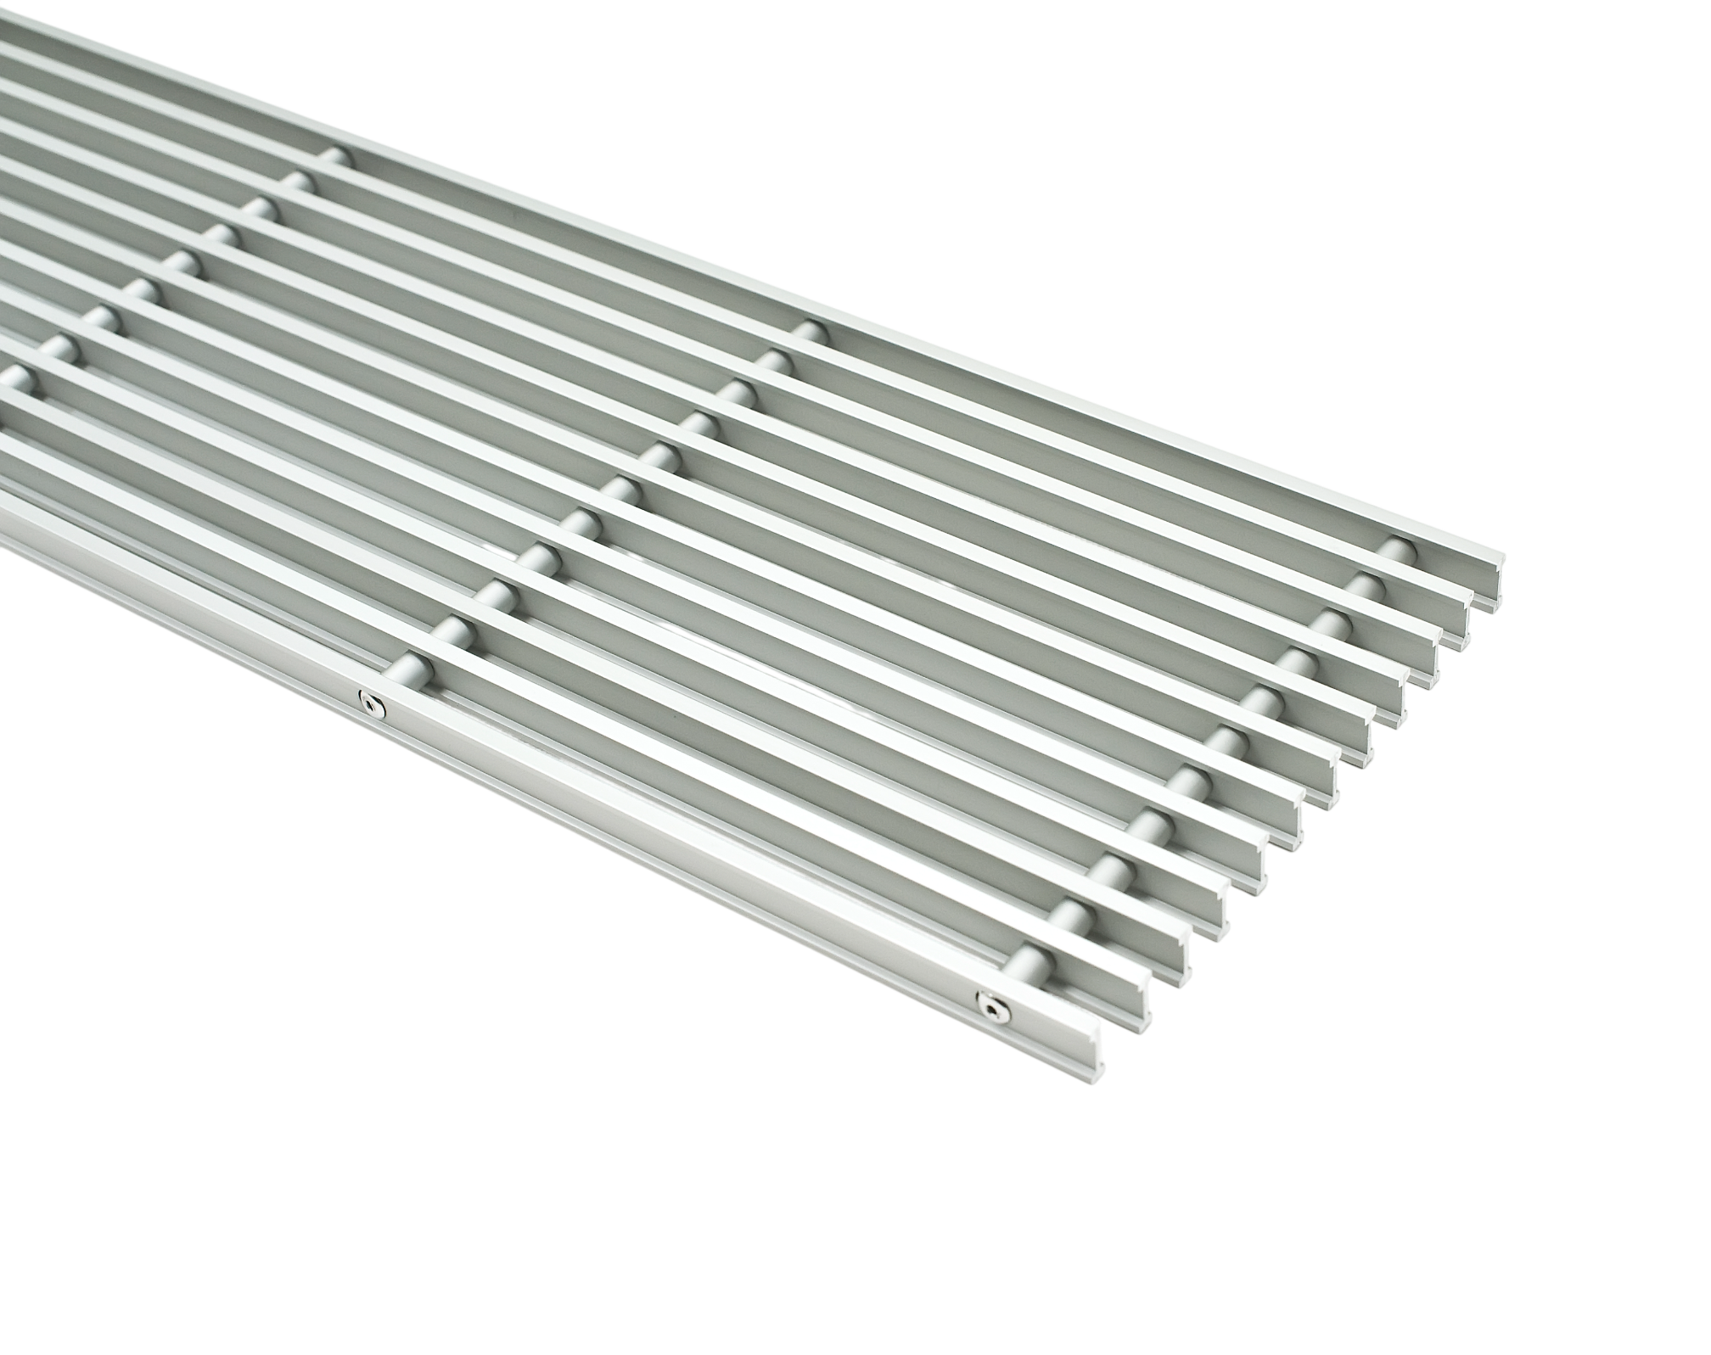
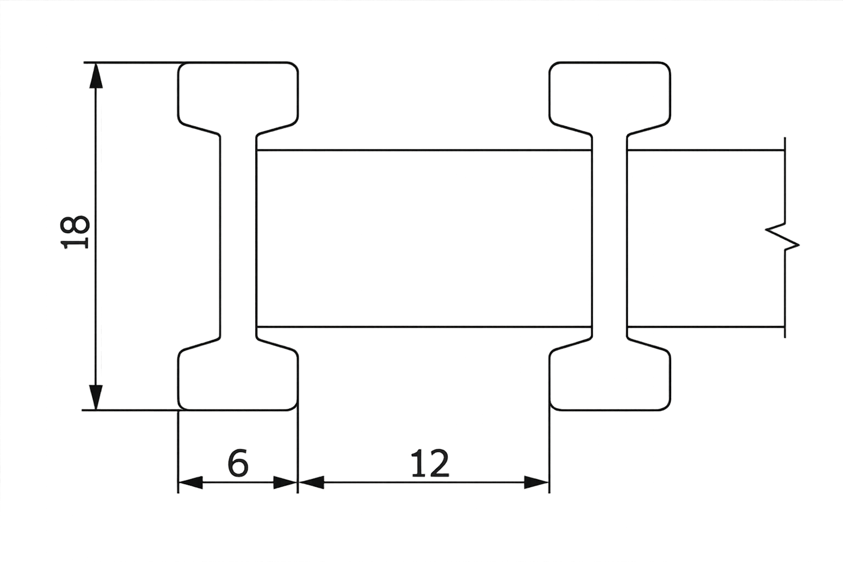
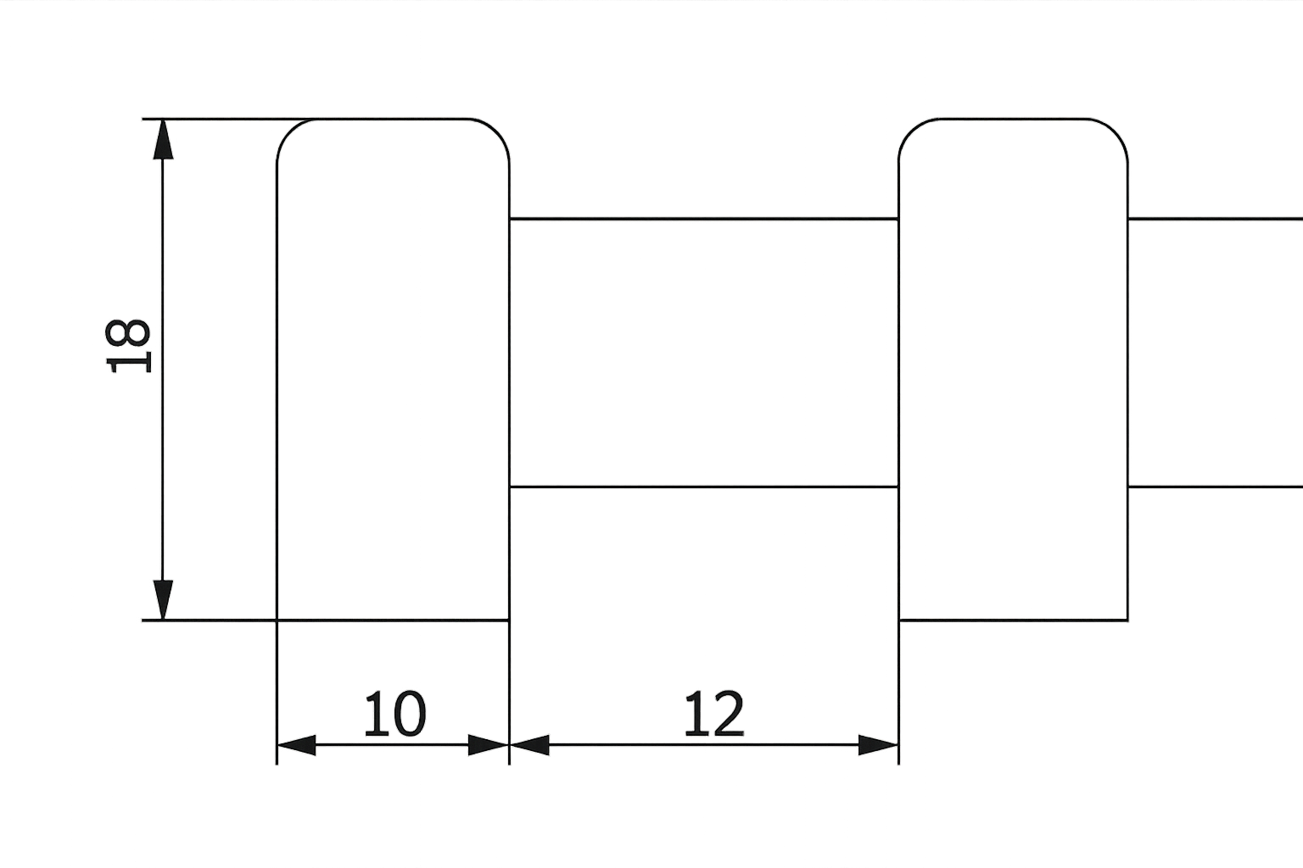
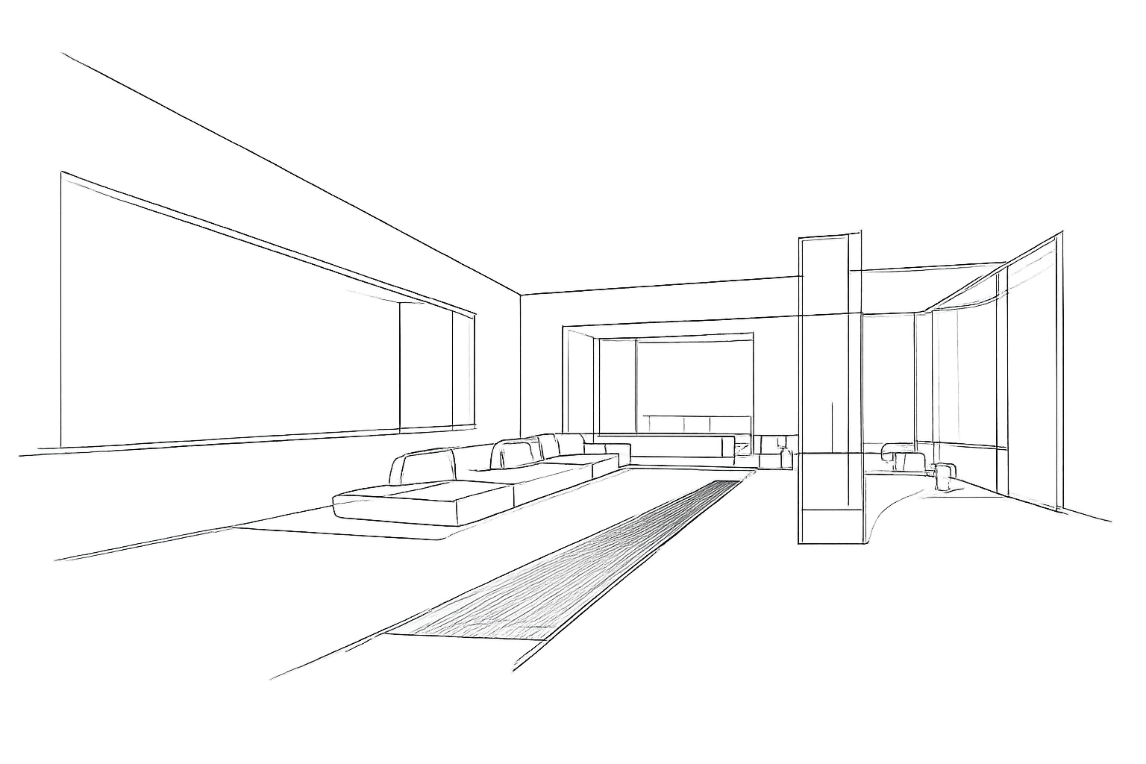
DESIGN OPTIONS, TAILORED
FOR EVERY INTERIOR
BLACK (AL 50)
OAK
Created for modern architecture,
where colour creates character
A natural choice for cosy,
for bright and harmonious interiors
GRILLE TYPES
ROLL-UP ALUMINIUM
GRILLES
LINEAR ALUMINIUM
GRILLES
WOODEN GRILLES
A classic choice that ensures strength and timeless design
Elegant lines that visually extend the space and create a seamless look
The natural beauty and warmth of wood, perfectly matching the highest-class interiors
PROFILE CROSS-SECTION
PROFILE CROSS-SECTION
PROFILE CROSS-SECTION
CUSTOM SOLUTIONS
CREATED FOR ARCHITECTURE
The length, width and colour of the grilles can be adapted to your project needs
Created for people who create exceptional spaces
11 | TRENCH HEATERS FC

Slide 12



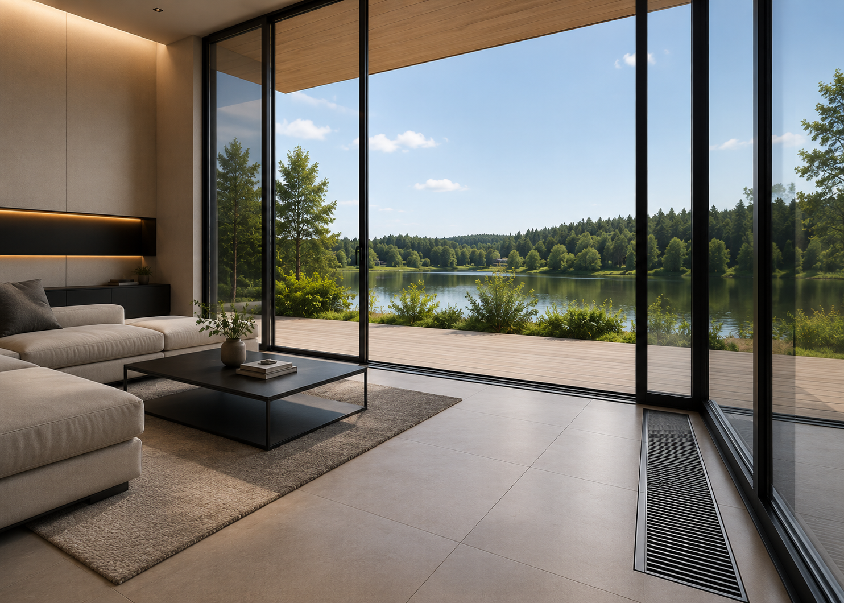
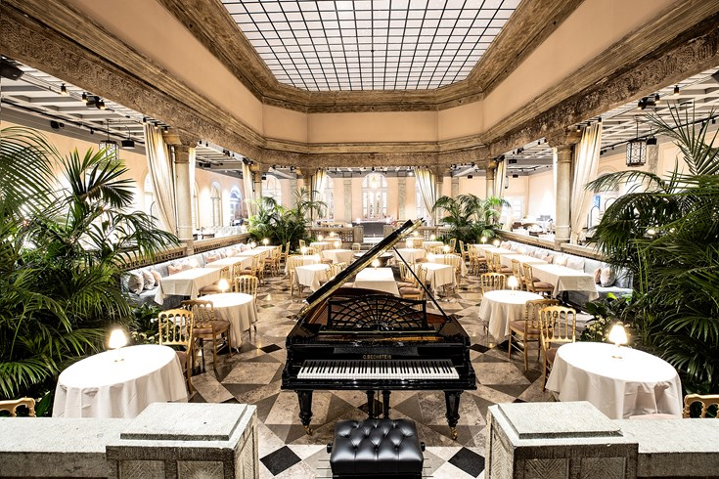
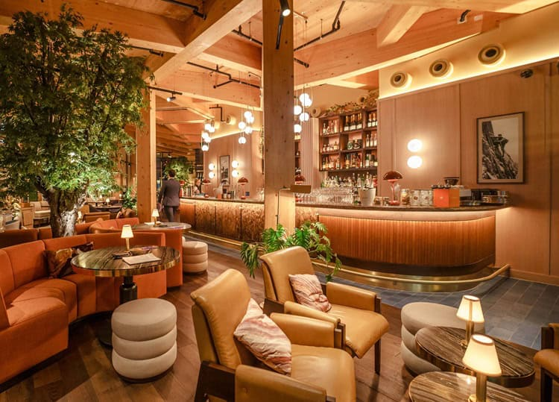
REAL PROJECTS
KONVEKA trench heaters are chosen in prestigious buildings worldwide, where comfort, reliability and architectural aesthetics matter most
RIGA, LATVIA
ADMINISTRATIVE BUILDING
Application
Offices
Product
FC
Grilles
Linear, aluminium
PRIVATE HOUSE
VILNIUS, LITHUANIA
HOTEL "BRITANNIA"
TRONDHEIM, NORWAY
RESTAURANT "THE PAVILION"
LONDON, UK
Application
Residential
Application
Hotel
Application
Restaurant
Product
FC
Product
FC
Product
FC
Grilles
Roll-up, aluminium
Grilles
Roll-up, aluminium
Grilles
Linear, aluminium
TRENCH HEATERS FC | 12

Slide 13
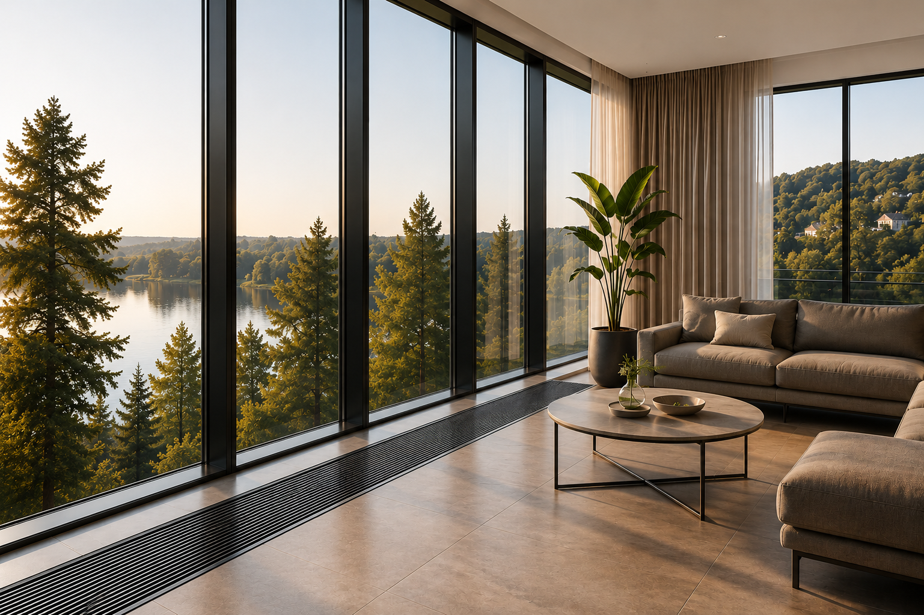







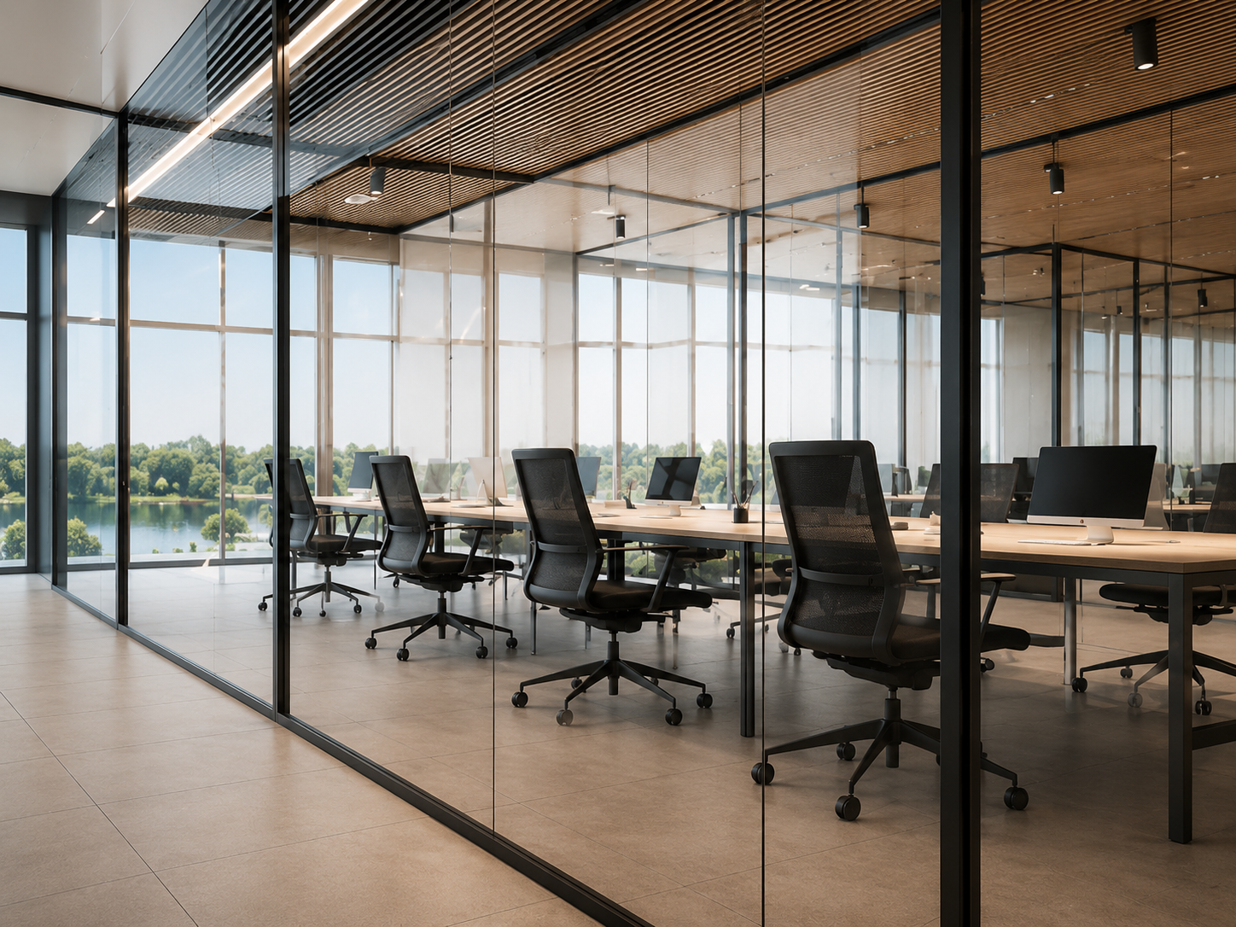
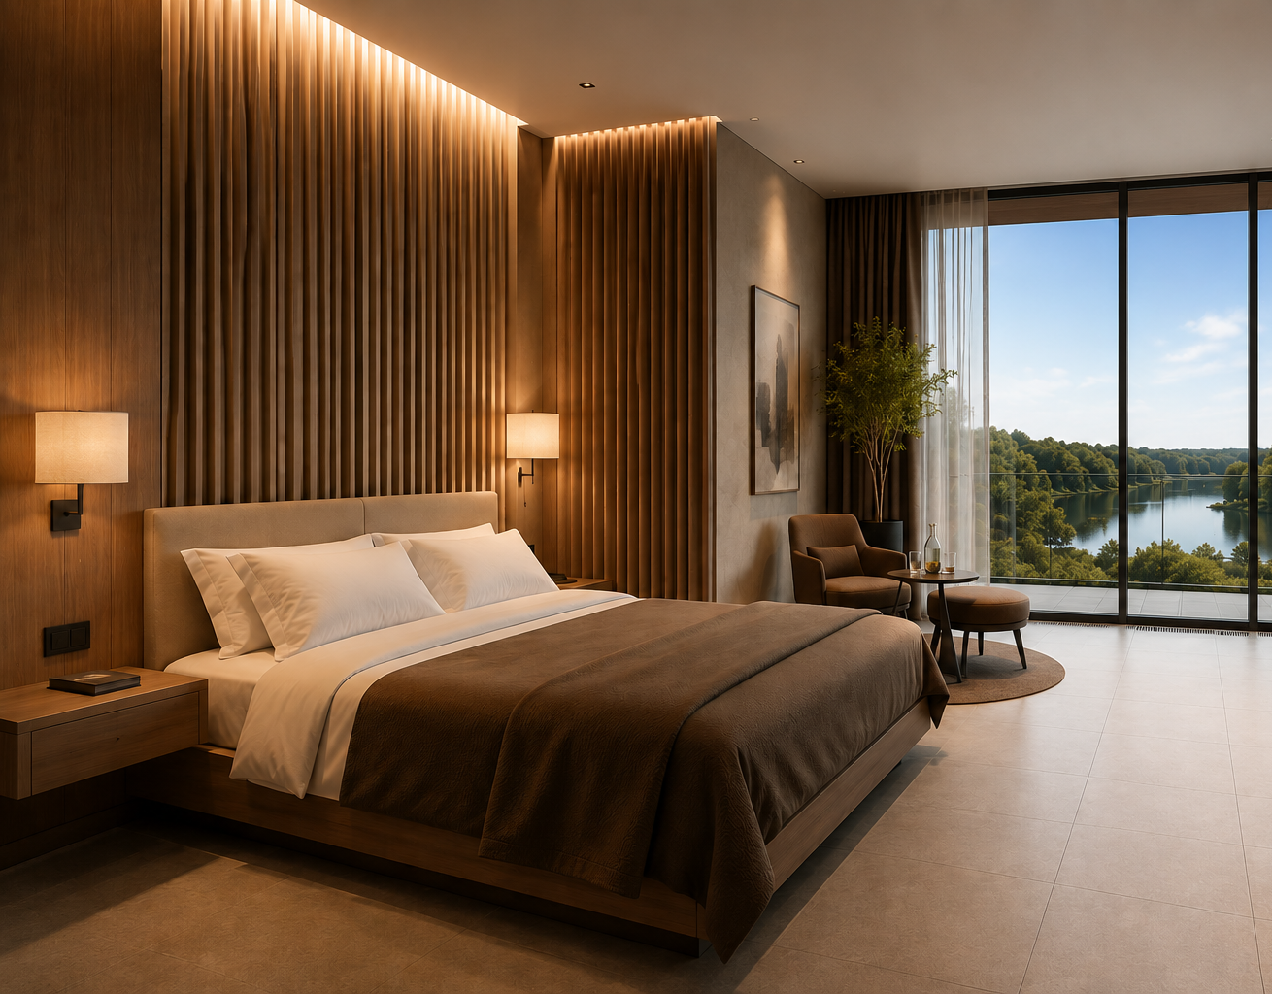
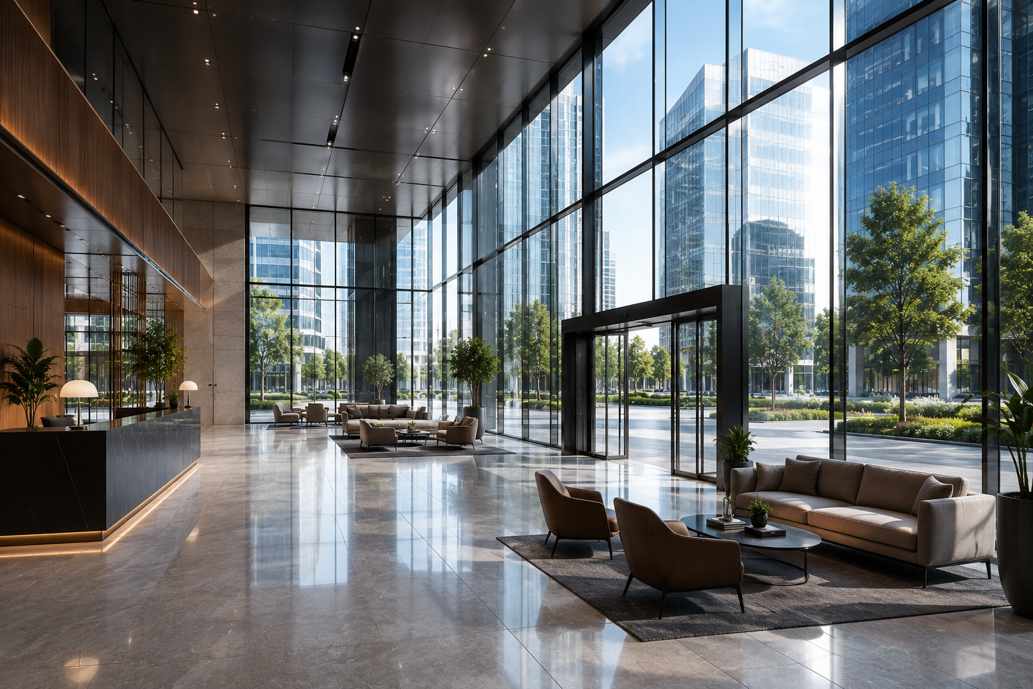
ABOUT KONVEKA
KONVEKA is a Lithuanian engineering company that has been creating top-quality trench heaters for contemporary architecture for more than 20 years.
Our solutions combine efficiency, reliability and aesthetics - so that buildings are not only functional but also inspiring
20+
YEARS OF EXPERIENCE
30+
COUNTRIES
1 000+
COMPLETED PROJECTS
EUROPEAN ENGINEERING
For more than two decades we have specialized in the field of convectors and fan coils
Our products are used worldwide
Reliable solutions in residential, commercial and public buildings
Created in Lithuania, to the highest quality standards
OUR VALUES
ARCHITECTURE FIRST
RELIABILITY
EFFICIENCY
COMFORT
FLEXIBLE SOLUTIONS
We create products that naturally blend into modern architecture
Top-quality materials and strict quality control
Maximum thermal efficiency and low energy consumption
Quiet operation and even heat - for comfort every day
A wide range for any project
KONVEKA SOLUTIONS - FOR CONTEMPORARY ARCHITECTURE
OFFICE COMPLEX
Vilnius, Lithuania
RESIDENTIAL COMPLEX
Stockholm, Sweden
HOTEL
Copenhagen, Denmark
CULTURAL CENTRE
Oslo, Norway
13 | TRENCH HEATERS FC

Slide 14
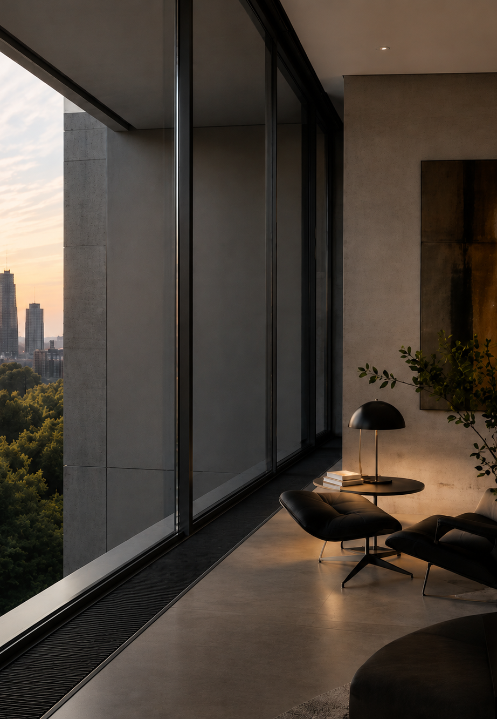


THE CULTURE OF HEAT
www.konveka.com
sales@konveka.lt
+370 677 06303

